Slide 1







FROM INSIGHT TO IMPACT:
BUILDING COMMUNICATIONS PLANS THAT WORK IN GOVERNMENT
Speakers: Jeanteil Livingston & Rachael Van Cleave, MBA, APR, APIO
Notes:
Our own intro? Or do we just go into it?

Slide 2
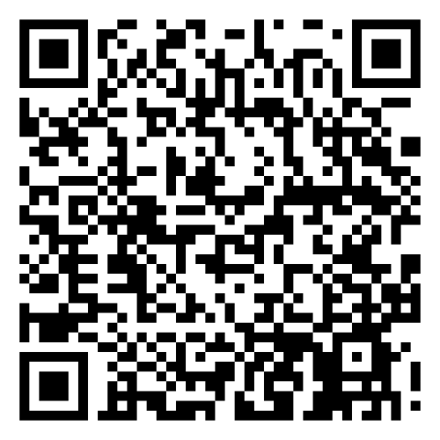

OVERVIEW
But, first, let’s do a poll! →
WHO SHOULD DO STRATEGIC COMMUNICATIONS PLANNING?
1
solo practitioners
2
small teams
3
large agencies
…basically...everyone.
Notes:
Rachael -Introduces poll and asks this question.

Slide 3


OVERVIEW
1
research tools
2
planning framework
3
real-world applications
Notes:
Jeanteil
Be honest, how many of you have sat through a presentation or meeting where you thought, “Just tell me the plan already!’?”
Unlike that interviewee, I’m not here to be mysterious. We do have a three-part plan and you’re going to get all of it today. We’ll look at:
Research tools like surveys, focus groups, social listening, etc.
Planning framework like the RPIE method Rachael will talk about
Real-world applications - How it actually work!

Slide 4


WHY IS
STRATEGIC COMMUNICATIONS PLANNING
IMPORTANT?
It can relieve common challenges in government communications
It can reduce the workload (costs) associated with reactive communication
It can increase efficiency, alignment with organization’s goals, and trust with your leadership
Notes:
Rachael - Why is strategic planning important?
What are some common struggles in government communications? Revisit poll results
Seat at the table, not being heard, thinking of communications last, capacity (small team) our residents are being impacted ultimately
Audience Interaction!

Slide 5
“COMMUNICATIONS IS THE LUBRICATION OF THE OPERATIONS MACHINE.”
WHY TRUST?
This means we’re here to help make your job easier…and you can TRUST us!
Notes:
Rachael

Slide 6
REMEMBER…
95/5 Rule - 95% of PIOs time is spent planning, the 5% is response.
Notes:
Jeanteil -
I’m sure there are plenty of people who think being a PIO means living in constant crisis mode, like we’re running around with our hair on fire, press release in one hand and microphone in the other. But the truth is, if that’s what our job looked like every day, none of us would survive very long. That’s where the 95/5 Rule comes in: 95% of our time should be planning and preparing, so that only 5% is actually responding. The response looks easy only because of all the work that came before it.
95/5 - 95% of PIOs time is spent planning, the 5% is response.
This is even more important for those wearing multiple hats or on small teams (outreach, education, etc.)
You never know when you are going to have an emergency - story here
Story ideas: Flood prevention and response
In 2023, when flood season was looming, we didn’t just cross our fingers and hope for the best. Weeks before, we brought together the Streets Department, Water Department, Engineering, and my office to map out a flood prevention and response plan. Everyone had a clear role, communication lines were set, and when the water came, so did our plan.
The result? Our residents stayed calm, our communication was consistent, and unlike many other communities across Utah that saw serious flooding, Lehi avoided the worst. That wasn’t luck, that was planning. That’s the 95/5 Rule in action: 95% preparation, 5% response.

Slide 7


“If you don’t know where you’re going, any road will take you there.”
If you don’t have a plan, you can wander in any direction, but you’re unlikely to end up where you want to be.
Notes:
You’ve probably heard the saying, ‘If you don’t know where you’re going, any road will take you there.’ What that really means is, if you don’t have a plan, you can wander in any direction — but you’re unlikely to end up where you want to be. That’s why in communications planning, we always come back to three pillars: research, relationships, and results.

Slide 8
STRATEGIC PLANNING
PILLARS
1
2
3
RESEARCH
RELATIONSHIPS
RESULTS
Research is your roadmap.
It really begins with listening. Listening to residents, listening to departments, even listening to what’s not being said..
Relationships are your traveling companions.
It’s what gives us the research power. We need allies inside departments who trust us, leadership who understands the value of communications, and residents who feel like we’re not just talking at them, but working with them.
Results are your destination.
Results are how we prove our work made a difference, that engagement increased, misinformation decreased, or that more people showed up, participated, or understood.
Notes:
Jeanteil -
The three pillars of effective planning
How they connect
You’ve probably heard the saying, ‘If you don’t know where you’re going, any road will take you there.’ What that really means is, without a plan, you can wander anywhere and end up nowhere. That’s exactly where the three pillars come in: research, relationships, and results.
Research is your roadmap. It helps you know where you’re starting and what path to take. Relationships are the traveling companions. The people who walk the journey with you, make sure you don’t get lost, and help you overcome obstacles. And results? That’s your destination. Without defining what success looks like, you don’t actually know if you’ve arrived.

Slide 9
Listening as a research strategy
1
Internal stakeholders (departments, leadership, staff)
2
External stakeholders (residents, partners, media)
3
Listening tools (meetings, surveys, focus groups, social listening)
4
Tactics for gathering insights: conversations, surveys, focus groups, polls
5
Look for needs and pain points; complaints can be opportunities.
Notes:
We just covered the three pillars of effective planning: research, relationships, and results. Let’s start with the first one, research. And the very first and most important research strategy is simply listening.

Slide 10
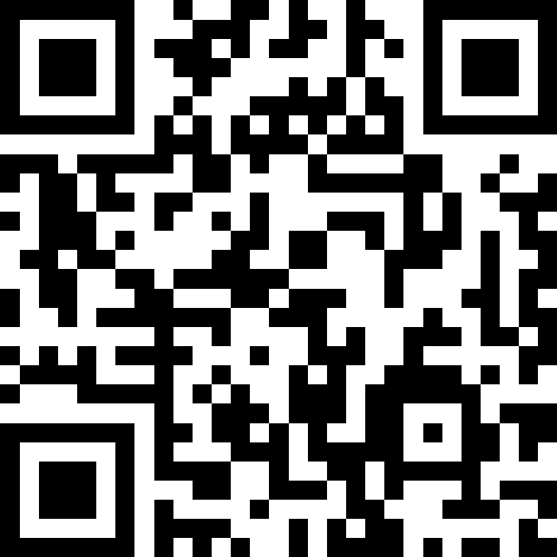
RELATIONSHIPS
It’s time for another live poll! →
Notes:
It’s time for another poll! As you can see relationships are complicated. Leveraging them is one of the most important parts of strategic planning. That’s why this is the longest portion of this presentation.

Slide 11
RELATIONSHIPS
are key to moving from reactive
to proactive communications
Have you heard this before?
“I need you to put this out on social media ASAP!”
“Let’s hold a press conference!”
“Can you make a flyer for that?”
Notes:
[Either of us can do this exercise]: By a raise of hands, in your capacity as a government communicator or PIO have you ever had someone in your organization come to you and say “I need you to put this out on social media, in the newsletter, etc. right away, for X, Y, Z, reason?”
Now, by a raise of hands, who here has ever said “no, for x, y, z reasons”?
That “no” is you moving your organization from reactive, to proactive communications. BUT, the key is, you have to have relationships with the people in those departments that are functional, and full of trust to do that.

Slide 12
RELATIONSHIPS
Ask to be included in meetings
1
Email department heads on a quarterly basis to see what their upcoming needs are
Reach out to departments proactively when you see residents are asking questions about issues in their span of control
Ask questions and communicate early and often.
Notes:
Rachael - Over the 7 years, I’ve worked at South Jordan City, I haven’t spent tireless hours agonizing on how to encourage departments to get me information earlier in their planning processes. One of the ways I have done this is by asking to be included on their meetings every so often, so I can have an idea of what’s going on in their departments. I’ll also email each department (director or associate director) on a quarterly basis to follow up on something I remember them mentioning, or to ask if they know of anything that’s coming up that our residents need to know about, even if it’s months from now. Also, proactively reach out to them if you see residents asking questions about things that concern their departments. Once you do this enough, they start notifying you more without you asking!

Slide 13
RELATIONSHIPS
Communicating in a way that builds trust
2
Creating allies across departments
Invite feedback and act on it
Consult with, don’t direct. People don’t like being told what to do.
Notes:
Jeanteil - [Jeanteil, I think this was your point about hearing people’s needs, this feeds off of the listening items on the previous slide] Feeling like you need to tell people what to do, versus listening (they are less likely to listen, more offended, you’re not hearing their needs)

Slide 14
RELATIONSHIPS
Set regular calendar reminders
3
Block out time on your calendar
Ask them to rate how urgent their request is against what you are already working on
Do what you say you would do and be consistent.
Notes:
Rachael - Trust = consistency: Do what you say you’ll do. This can be difficult when we have things thrown at us all the time and their urgency becomes our emergency. I recommend a few things for staying organized. Setting regular reminders in your calendar to check back in with someone. Setting blocks of time aside in your calendar to work on strategic items or planned items. Also, I have found it helpful to ask how urgent they would rate their request.
Helping departments anticipate needs

Slide 15
RELATIONSHIPS
Know who you can reach out to in your organization who can help fill your capacity gaps
4
See it as a mentoring, or skill-building opportunity within your organization
Ask for outside help.
(Especially if you are on a smaller team)
And…Reach out to your fellow PIOs. We’re here to help!
Notes:
As the city spokesperson, people often assume I have every answer about every city service at my fingertips, but the truth is, I don’t. And that’s okay. What makes me effective is knowing how to ask for help.
In Lehi, we have a Facebook group called City Chat. We get all sorts of questions, such as street repairs, a water issue, or even a low-flying helicopter. Thank goodness for Teams. We have set up a system on Teams to ask interdepartmental questions. I couldn’t do my job nearly as well without that internal network. Relying on my colleagues’ expertise makes me a stronger spokesperson because I can share accurate, timely information with the public.
Jeanteil, this is me just ordering the remainder of the notes we had in the doc, if you’d like to go another direction, please do!!!
(A story here may be good!)
Ask for help!

Slide 16
RELATIONSHIPS
Build credibility over time by reminding them of what you’ve already done.
5
Ex: Remember how last time this came up, we did “X,Y,Z” and it went really well?
Use the Velvet Hammer Approach.
And put in for awards. You do good work, but sometimes it’s seen in better light when you have an award to show for it!
Notes:
Building credibility over time (Velvet Hammer, remind them of what you’ve done for them)
Add Examples of things you can say to remind them.
No Egos Amigos

Slide 17
RELATIONSHIPS
It’s easy to let our egos to get in the way
6
Remember, you and others in your org are trying to do the best job possible
Sometimes you have to say it out loud to help people come off the defensive - “Hey, I want you to be successful, and that’s why I am here!”
Let’s be
“No Egos Amigos”
Notes:
Story here…
No Egos Amigos

Slide 18



PLANNING & RESULTS
(RPIE Process)
Research
Surveys & Focus Groups
Listening
Primary &
Secondary
Measure
Against
Objectives
RPIE
Narrow down audiences
Evaluation
Analyze
Data
Develop
SMART
Objectives
Planning
Make
Adjustments
For the future
Determine Strategies
Execute
Tactics
Monitor
(and pivot)
Follow
Schedule
Implementation

Slide 19
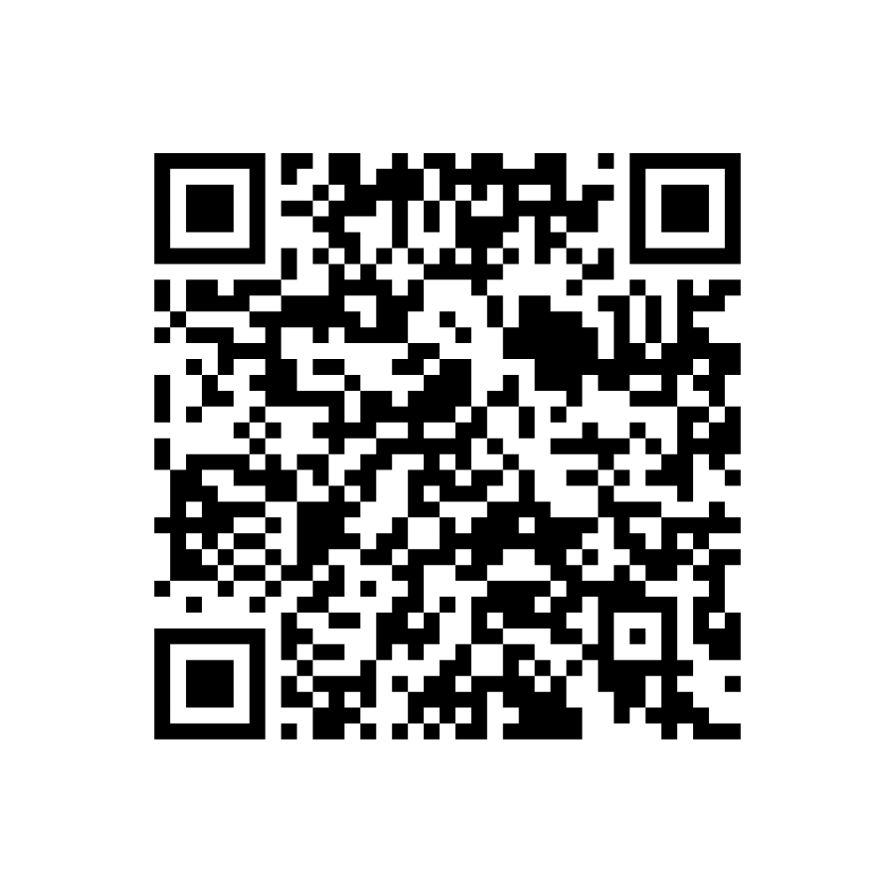
SMART
OBJECTIVES
Specific. Measurable. Attainable. Timebound.
To
[increase/decrease/maintain]
+
[Specific behavior/awareness/attitude/perception]
among
[Defined audience]
by
[Measureable percentage/number/level]
by
[Specific deadline]
,
As measured by
[Evaluation method]
.
AMEC Framework
Notes:
Jeanteil
To run them through the example using ChatGPT, here is the formula you can cut and paste:
To [increase/decrease/maintain] [specific behavior/awareness/attitude/perception] among [defined audience] by [measurable percentage/number/level] by [specific deadline], as measured by [evaluation method].
ChatGPT Prompt: Help me write a SMART communications objective using this formula: to [increase/decrease/maintain] [specific behavior/awareness/attitude/perception] among [defined audience] by [measurable percentage/number/level] by [specific deadline], as measured by [evaluation method].
Possible scenario: I want more residents to sign up for emergency alerts before firework season. The target audience is homeowners in the Traverse Mountain area. I’d like to see a 20% increase by June 1, as measured by alert system registrations.
ChatGPT Output: To increase enrollment in the city’s emergency alert system among Traverse Mountain homeowners by 20% before firework season, with the goal achieved by June 1, as measured by the number of new alert system registrations.
Also, show them the tool - you may want to include a QR code on the screen to link to it.
Tool (https://amecorg.com/amecframework/framework/interactive-framework/)

Slide 20
PLANNING & RESULTS
(RPIE Process)
Research
Surveys & Focus Groups
Listening
Primary &
Secondary
Measure
Against
Objectives
RPIE
Narrow down audiences
Evaluation
Analyze
Data
Develop
SMART
Objectives
Planning
Make
Adjustments
For the future
Determine Strategies
Execute
Tactics
Monitor
(and pivot)
Follow
Schedule
Implementation

Slide 21
PLANNING
Narrow Down Audiences
There is no “general public”
Define who matters most
Segment by relevance and impact
Prioritize Strategically
Notes:
Rachael
There is no “general public.”
Define who matters most → Identify the specific public(s) that have the greatest influence on or are most affected by your goal, rather than trying to reach “everyone.”
Segment by relevance and impact → Break audiences into subgroups (e.g., residents vs. business owners, commuters vs. seniors) based on demographics, behaviors, attitudes, or level of influence.
Prioritize strategically → Choose the audience(s) where communication can realistically create measurable change in awareness, attitude, or behavior within your campaign timeframe.

Slide 22
PLANNING
Determine Strategies
Strategies are the big picture - “the how”
Align with objectives
Leverage research insights
Stay audience-centered - the “who”
Notes:
Rachael
Strategies are “the how”- They define the broad approach you’ll take to influence awareness, attitudes, or behaviors (education, engagement, relationship-building, persuasion, etc.).
Align with objectives → Ensure strategies directly support your SMART objectives and desired outcomes.
Leverage research insights → Base strategies on what you know about your audience’s motivations, barriers, and preferred channels.
Stay audience-centered → Make choices that are meaningful to the audience’s needs and perspectives, not just organizational convenience.

Slide 23
PLANNING & RESULTS
(RPIE Process)
Research
Surveys & Focus Groups
Listening
Primary &
Secondary
Measure
Against
Objectives
RPIE
Narrow down audiences
Evaluation
Analyze
Data
Develop
SMART
Objectives
Planning
Make
Adjustments
For the future
Determine Strategies
Execute
Tactics
Monitor
(and pivot)
Follow
Schedule
Implementation

Slide 24
IMPLEMENTATION
Tactics are the “what”
This is where you identify channels & activities
Identify who is accountable for what
Build a timeline/schedule
Monitor and pivot as necessary
Notes:
Rachael
Translate strategies into action → Select the specific tools, channels, and activities (press releases, social posts, videos, events, etc.) that carry out the broader approach.
Assign responsibility → Clarify who is accountable for each tactic to ensure follow-through.
Build a timeline → Assign deadlines, sequence tasks, and map tactics to campaign milestones.
Stay flexible → Monitor performance and be ready to adjust tactics if audience feedback or circumstances change.
Ex: Bees engagement idea (coloring page) if there is time.

Slide 25
EVALUATION
Measure against objectives
Analyze data and take what’s useful
Make adjustments for the future
Notes:
Rachael
Measure against objectives → Did I achieve what I set out to?
Analyze Data → What did I learn from this?.
Use this for the future → Running this campaign can serve as primary research for the next one. You can use it to set new baselines for objectives, inform strategy and more.

Slide 26
TAKEAWAYS
What can you do right away?
Schedule a meeting with every department/stakeholder
Listen First
Listening to stakeholders ensures your plan meets real needs and builds trust.
No Egos Amigos!
Team Size Doesn’t Matter
You don’t need a large team to plan strategically, you need a strong process.
Be S.M.A.R.T.
SMART objectives and the RPIE model turn good intentions into measurable results.
Build Relationships
Relationship-building is just as important as messaging, follow through matters.
Notes:
Both of us - Jeanteil, you start
Listen first - Listening to stakeholders ensures your plan meets real needs and builds trust.
Adapt for any team size - You don’t need a large team to plan strategically, you need a strong process.
Use SMART goals to guide strategy - SMART objectives and the RPIE model turn good intentions into measurable results.
Relationship-building is just as important as messaging, follow through matters. AND…Don’t let them forget you or what you’ve done for them.
What to start doing tomorrow – Schedule a meeting with every department/stakeholder
No Egos Amigos!

Slide 27
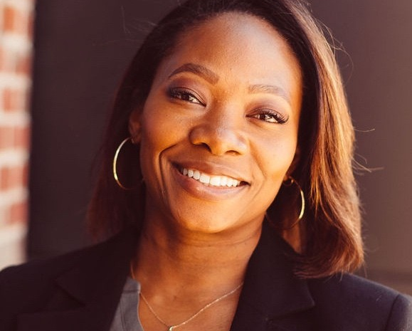
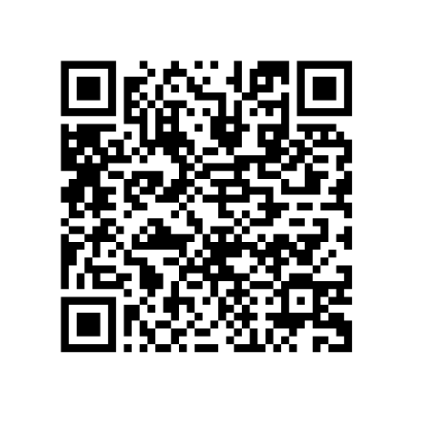
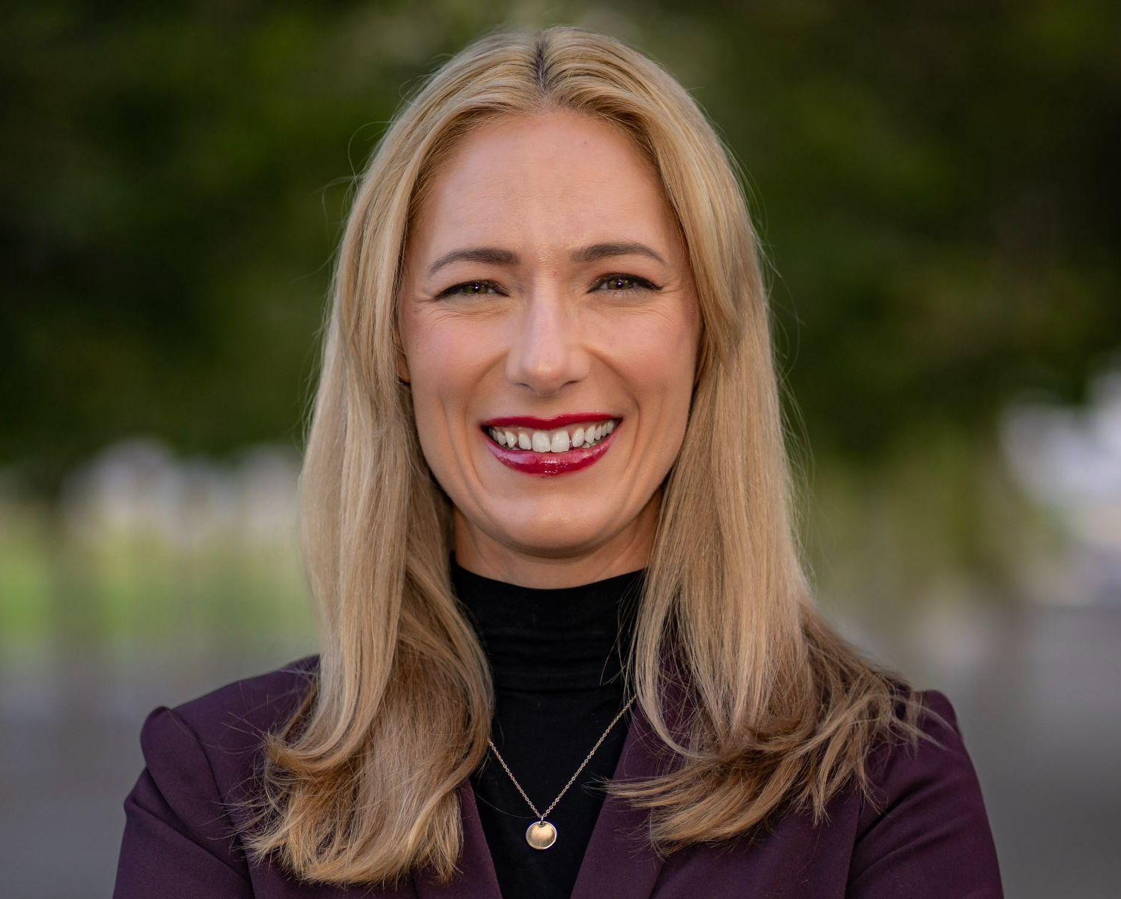
Questions, Resources, & Connection
Jeanteil Livingston
Rachael Van Cleave
THANK YOU
Questions?
Ask away!
Resources
Scan the QR codes to get access to strategic plan examples, useful links, and more!
Connect with us!
Reach out to us on Linkedin! We’d love to get to know you!
Linkedin: @jeanteil-livingston
Linkedin: @rachaelvancleave

Slide 28

PERSONA
NAME
ATTRIBUTES
“
ATTRIBUTE
ATTRIBUTE
QUOTE THE PERSONA ON THEIR NEEDS AND WANTS. THIS CAN BE A FICTIONAL LINE OR AN EXCERPT FROM A REAL USER INTERVIEW.
ATTRIBUTE
ATTRIBUTE
GOALS & NEEDS
AGE
21
What do they want to achieve and why?
What do they want to achieve and why?
What do they want to achieve and why?
OCCUPATION
Job title
BIO
STATUS
Marital status
Introduce your audience persona, including who they are and where they come from. Think about a hypothetical user or customer who represents an audience segment. Although the individual might be fictional, the insights should be derived from your audience research.
EDUCATION
Highest education
FRUSTRATIONS
LOCATION
Place name
What specific obstacles are they facing?
What specific obstacles are they facing?
What specific obstacles are they facing?
ARCHETYPE
Tech lover
Confidential

Slide 29
WRITE A PERSUASIVE STATEMENT ABOUT THE CURRENT MARKET OR INDUSTRY CONTEXT
Explain why your campaign or marketing plan is relevant right now.
Think about the challenges your market or industry is facing, and justify the need for your plan.

Slide 30
BUSINESS
OBJECTIVES
Now that you’ve described your campaign objectives, explain how they contribute to long-term business goals. Use the graph to visualize your point.
Expand market footprint
Increase revenue
Acquire new customers
Campaign objective 1
Campaign objective 2
Campaign objective 3
Confidential

Slide 31




A CLAIM ABOUT THE ROLE OF
MARKETING CHANNELS
CHANNEL
NAME
CHANNEL
NAME
CHANNEL
NAME
CHANNEL
NAME
Audience
Audience
Audience
Audience
Identify the segment you hope to reach.
Identify the segment you hope to reach.
Identify the segment you hope to reach.
Identify the segment you hope to reach.
Actions
Actions
Actions
Actions
Describe a method you'll use to reach your target audience, such as a video ad, a viral post, or thought leadership content.
Describe a method you'll use to reach your target audience, such as a video ad, a viral post, or thought leadership content.
Describe a method you'll use to reach your target audience, such as a video ad, a viral post, or thought leadership content.
Describe a method you'll use to reach your target audience, such as a video ad, a viral post, or thought leadership content.
Goal
Goal
Goal
Goal
Share your marketing objectives or calls to action.
Share your marketing objectives or calls to action.
Share your marketing objectives or calls to action.
Share your marketing objectives or calls to action.
Confidential

Slide 32
HOW WE’LL MEASURE
CAMPAIGN SUCCESS
Platform
Key performance indicators
CHANNEL NAME
KPI 1
KPI 2
KPI 3
KPI 4
CHANNEL NAME
KPI 1
KPI 2
KPI 3
KPI 4
CHANNEL NAME
KPI 1
KPI 2
KPI 3
KPI 4
CHANNEL NAME
KPI 1
KPI 2
KPI 3
KPI 4
CHANNEL NAME
KPI 1
KPI 2
KPI 3
KPI 4
CHANNEL NAME
KPI 1
KPI 2
KPI 3
KPI 4
Confidential

Slide 33
HOW WE’LL MEASURE
CAMPAIGN SUCCESS
CHANNEL
NAME
CHANNEL
NAME
CHANNEL
NAME
CHANNEL
NAME
Introduce the key performance indicators (KPIs) for each channel. You might have a single KPI or several.
Introduce the key performance indicators (KPIs) for each channel. You might have a single KPI or several.
Introduce the key performance indicators (KPIs) for each channel. You might have a single KPI or several.
Introduce the key performance indicators (KPIs) for each channel. You might have a single KPI or several.
KPI 1
KPI 1
KPI 1
KPI 1
KPI 2
KPI 2
KPI 2
KPI 2
KPI 3
KPI 3
KPI 3
KPI 3
Confidential

Slide 34



CAMPAIGN STAGE:
PLANNING AND DEVELOPMENT
In a few lines, explain what needs to happen during the opening stages
of the campaign.
For example, you might have to set goals, agree on a budget, develop your media strategy, and build a team.
You can talk about each step in paragraphs or bullet points. Use whatever is clearest for your audience.
Confidential

Slide 35
CAMPAIGN STAGE:
PLANNING AND DEVELOPMENT
In a few lines, explain what needs to happen during the opening stages
of the campaign.
For example, you might have to set goals, agree on a budget, develop your media strategy, and build a team.
You can talk about each step in paragraphs or bullet points. Use whatever is clearest for your audience.
Confidential

Slide 36
CAMPAIGN STAGE:
PLANNING AND DEVELOPMENT
In a few lines, explain what needs to happen during the opening stages
of the campaign.
For example, you might have to set goals, agree on a budget, develop your media strategy, and build a team.
You can talk about each step in paragraphs or bullet points. Use whatever is clearest for your audience.
Confidential

Slide 37



CAMPAIGN STAGE:
EXECUTION AND LAUNCH
With the planning out of the way,
it’s time to make the
campaign a reality.
Depending on the nature of your campaign, this might involve creating
your marketing content, hiring external contractors, or partnering with influencers.
You can also mention the specific asset types that you'll be producing as part of the campaign.
Confidential

Slide 38
CAMPAIGN STAGE:
EXECUTION AND LAUNCH
With the planning out of the way,
it’s time to make the
campaign a reality.
Depending on the nature of your campaign, this might involve creating
your marketing content, hiring external contractors, or partnering with influencers.
You can also mention the specific asset types that you'll be producing as part of the campaign.
Confidential

Slide 39
CAMPAIGN STAGE:
EXECUTION AND LAUNCH
With the planning out of the way,
it’s time to make the
campaign a reality.
Depending on the nature of your campaign, this might involve creating
your marketing content, hiring external contractors, or partnering with influencers.
You can also mention the specific asset types that you'll be producing as part of the campaign.
Confidential

Slide 40



CAMPAIGN STAGE:
MONITORING AND ANALYSIS
Now that the campaign has reached its final stages, what needs to happen before it wraps up?
This could be the time to analyze your KPIs, hold a retrospective with the team, and review your budget.
If your campaign doesn't have a definite endpoint, describe that here. You may have post-launch releases or a long-term content pipeline.
Confidential

Slide 41
CAMPAIGN STAGE:
MONITORING AND ANALYSIS
Now that the campaign has reached its final stages, what needs to happen before it wraps up?
This could be the time to analyze your KPIs, hold a retrospective with the team, and review your budget.
If your campaign doesn't have a definite endpoint, describe that here. You may have post-launch releases or a long-term content pipeline.
Confidential

Slide 42
CAMPAIGN STAGE:
MONITORING AND ANALYSIS
Now that the campaign has reached its final stages, what needs to happen before it wraps up?
This could be the time to analyze your KPIs, hold a retrospective with the team, and review your budget.
If your campaign doesn't have a definite endpoint, describe that here. You may have post-launch releases or a long-term content pipeline.
Confidential

Slide 43
BUDGET
Stage 1
Stage 2
Stage 3
PHASE 1
$00
$00
$00
PHASE 2
$00
$00
$00
PHASE 3
$00
$00
$00
TOTAL
$00
$00
$00
Confidential

Slide 44
THANK
YOU!
Use this space to encourage your audience to reach out if they have any questions, doubts, or concerns about the contents of this presentation.
Share relevant contact details and invite your audience to continue the conversation at a later date.
CONTACT OUR TEAM
name@example.com

Slide 45
Planning & Results
(RPIE)
1
RESEARCH
This one we talked about:
Listening
Surveys
Primary & Secondary
2
PLANNING
Narrow down audience
Develop SMART Objectives
Determine strategies
3
IMPLEMENTATION
Tactics
Schedule
Monitor (and pivot as necessary)
4
EVALUATION
Measure your objectives
What would you change for next time?
Confidential

