Slide 1


It’s a Formal Regulation, Not Just Guidance: New ADA Rules
Web & Mobile Accessibility
Under Title II of the ADA
Notes:
Today we’re talking about a big change in ADA compliance. The Department of Justice isn’t just giving general advice anymore,they’ve laid down official, enforceable rules for web accessibility.
The DOJ has updated the rules so that state and local governments must make their websites and mobile apps accessible to people with disabilities. This means following specific technical standards so that people who are blind, deaf, have mobility issues, cognitive disabilities, etc., can use them without barriers.

Slide 2



Before
After
Flexible, best-practice recommendations.
Mandatory WCAG 2.1 AA compliance under federal law.
Notes:
For years, ADA web compliance was all about broad principles. Agencies had a lot of leeway in how they interpreted ‘effective communication’ for people with disabilities. But now the DOJ has set a clear, enforceable standard, WCAG 2.1 Level AA (title 2). This isn’t a suggestion anymore, it’s a requirement.

Slide 3



Rule Snapshot
Effective Date
Large Entities Deadline
Small Entities & Special Districts Deadline
Population
(≥50,000)
Population (<50,000)
June 24, 2024
April 24, 2026
April 26, 2027
Standard: WCAG 2.1 Level AA
Applies to: Websites, mobile apps, vendor content
Notes:
Here’s what you need to know: the rule kicked in on June 24, 2024. Large public entities have until April 2026 to comply, smaller ones until April 2027. The technical bar is set and it applies to everything: your own websites, your mobile apps, and even the digital services you get from 3rd party vendors.

Slide 4
Examples of Accessibility Standards (WCAG 2.1 AA) in Plain Language
Images
Add alt text that describes what the picture shows (not “image123.jpg”).
Decorative images should be marked as decorative so screen readers skip them.
Text & Colors
Color contrast: text needs to stand out clearly against its background
Don’t use color alone to convey meaning (e.g., “items in red are required” should also have an asterisk or label).
Videos & Audio
Captions for all spoken content in videos.
Audio descriptions if important visual info isn’t spoken aloud (e.g., “the sign flashes ‘Evacuate Now’”).
Transcripts for podcasts and audio-only recordings.
Notes:
WCAG 2.1 AA is a technical standard; all these items are practical examples of what compliance looks like.
Essentially, if someone can’t see, hear, or use a mouse, they should still be able to use your digital content.

Slide 5
Examples of Accessibility Standards (WCAG 2.1 AA) in Plain Language
Navigation
Must work with keyboard only (no mouse required).
Clear headings and labels so screen readers can move through content easily.
Skip links or landmarks so users can jump past repeated menus.
Documents & PDFs
PDFs must be tagged properly (headings, lists, reading order).
Forms must have labels that describe each field (e.g., “Name” not just a blank box).
Forms & Interactive Features
Every form field has a text label that’s read by screen readers.
Error messages must explain what went wrong and how to fix it (not just “Invalid input”).
Links & Buttons
Links should be descriptive: “View City Council Agenda” not “Click here.”
Buttons need meaningful labels (“Submit Payment”) not just an icon with no description.

Slide 6
Examples of Accessibility Standards (WCAG 2.1 AA) in Plain Language
Mobile Apps
Buttons big enough to tap easily.
Screen reader compatibility (VoiceOver, TalkBack).
Dynamic content (like pop-ups) announced to screen readers.
Language & Readability
Set the page language in the code (so screen readers know what voice to use).
Use plain, clear language whenever possible.
Timing
If something is time-limited (like an online form), provide a way to request more time.

Slide 7

Scope & Coverage
Covers:
  All public-facing web content
  Mobile apps
  Vendor/contractor platforms that deliver your services
Your Mobile App
Third-Party Vendors
You
Your Website
Notes:
This applies to all your public-facing web and app content, even if provided by a third party. That means things like your online forms, scheduling tools, payment systems....anything the public interacts with.

Slide 8

Exceptions & Special Rules
Exceptions may apply when compliance causes fundamental alteration or undue burden.
Exemptions include:
  Archived web pages
  Preexisting non-web documents (e.g., older PDFs)
  Password-protected content
  Uncontracted third-party content
  Social media posts posted before the rule’s effective date
Notes:
The rule has exceptions, like archived content, older PDFs, and social posts made before the rule’s effective date. But remember—these are narrow carve-outs, not loopholes.

Slide 9


Next Steps: Compliance Strategy
Inventory
Prioritize Content
Work with IT/Vendors
Your city’s digital content
(web, apps, PDF’s, videos, forms...)
*Remove outdated, trivial content from website.
Start with what people use most
(Utility payments, city council meeting notices, permit applications...)
Ensure that procurements are accessible using contract language and required testing
Staff Training
Communicate
Policy Creation
All employees who create or share public-facing content must receive training. This includes items such as staff reports, presentations, and similar materials.
Public: Accessibility efforts & provide a feedback channel
Internal: Templates and instructions
Draft accessibility policies, define roles, assign ADA coordinator.
Notes:
You won't do all the technical parts, but you have a very important role. Here’s what PIOs should be thinking about.
Know what digital content your city produces so you can plan for accessibility.
Start with the most important and frequently used services (utility payments, council agendas, permits).
Make sure accessibility is built into websites, apps, and contracts from the start.
Train your team on writing web copy, adding alt text, designing for readability, and captioning videos.
Everyone who publishes public-facing material — from staff reports to presentations — must know the basics of accessibility.
Post an accessibility statement, explain that you’re working on improvements, and give people with disabilities a clear way to report problems.

Slide 10
This is a Regulation.
The Deadlines Are Real.
But who is actually responsible for ensuring compliance?
Who is leading the efforts in your agency?
Research and identify who in your city holds that responsibility.
Communicators must have a seat at the table.
Notes:
This is no longer best-practice advice—it’s federal regulation. The standards are specific, the deadlines are set, and the expectation is that you will be ready.
Everyone has a role in accessibility. Who is leading the efforts in y our agency?
Communicators must have a seat at the table.

Slide 11
Rule Snapshot
Effective Date
Large Entities Deadline
Small Entities & Special Districts Deadline
Population
(≥50,000)
Population (<50,000)
June 24, 2024
April 24, 2026
April 26, 2027
Standard: WCAG 2.1 Level AA
Applies to: Websites, mobile apps, vendor content
Notes:
Here’s the compliance timeline again.

Slide 12

Resources
Official DOJ Resources
ADA.gov First Steps Guide
WCAG 2.1 AA Checklist & Tools
Webaim (Training and Resources)
Accessible.org WGAC Checklist
Massachusetts State Website
Mass.gov (Incredible Policy and Action Steps)
Notes:
Massachusetts has some great policies and best practices.

Slide 13
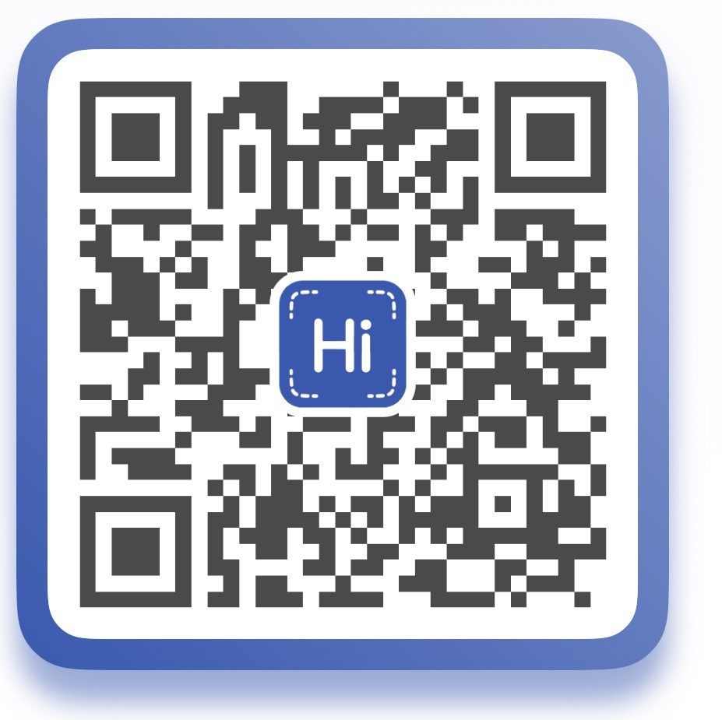

Questions?
Contact Info
Laura Magness

