Slide 1

Small Team Big Impact:
How to Stay Productive, Responsive, and Effective in Public Outreach
Small Team, Big Impact: The 4 Ts of Thriving as a PIO

Slide 2
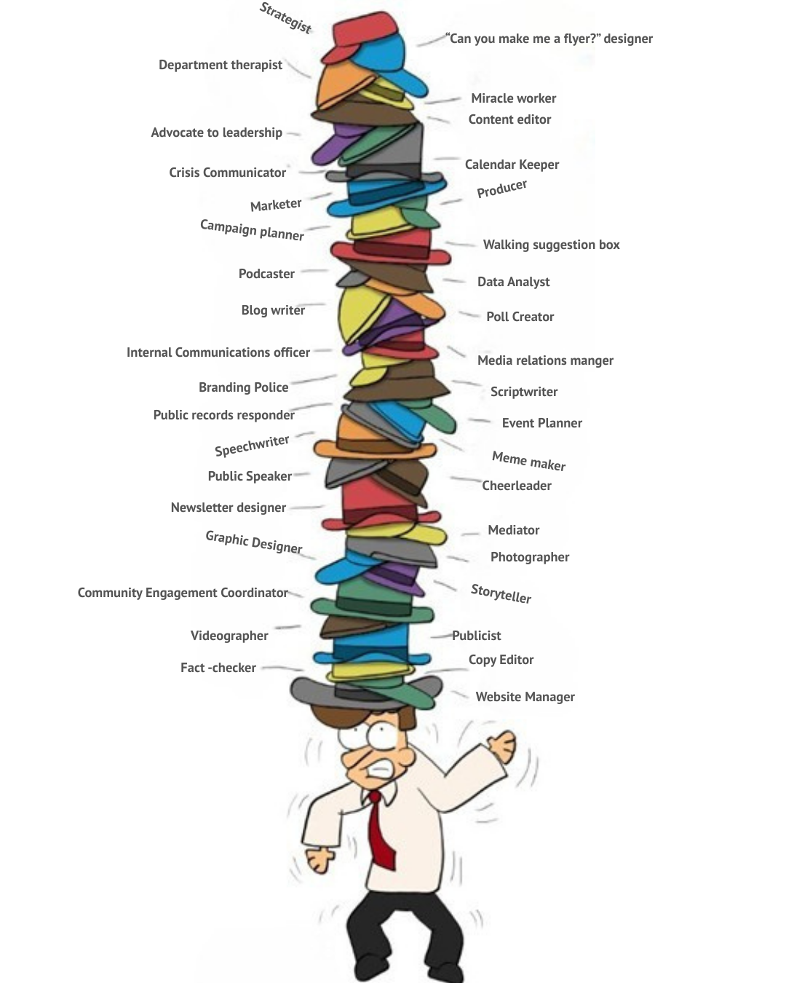

Slide 3

4 T’s Framework
Tenacity
Trust
Tools
Traction

Slide 4

Tenacity
“Showing up, even when you feel like a imposter.”

Slide 5
Confidence = Productivity
Without confidence, productivity suffers.
With confidence, you move forward.
  You take initiative.
  You focus.
  You make better decisions.

Slide 6
“Your skills. Your education. Your experience. Remember why you’re here.”

Slide 7
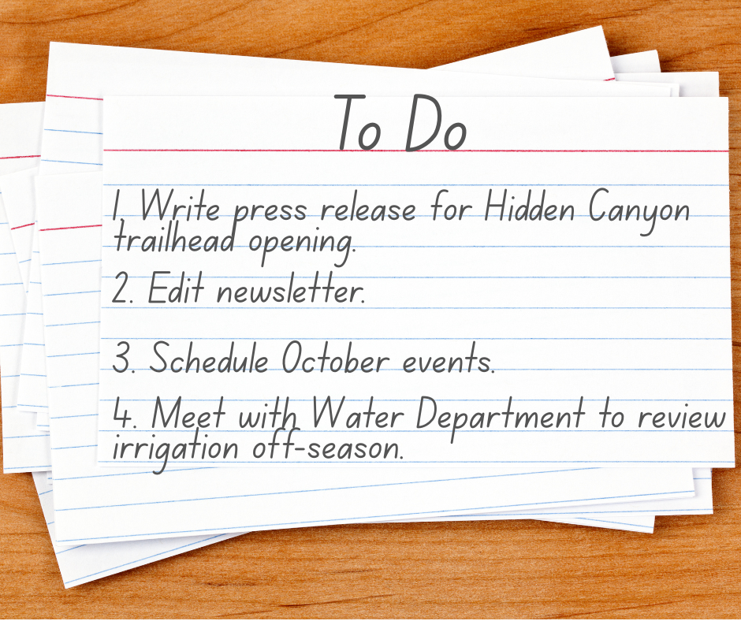
Productivity: 3 x 5 Rule
(Marc Andreessen)
At the end of the day, write 3 - 5 things on a card to accomplish the next day.
The next day focus on those items on your list and complete them.

Slide 8
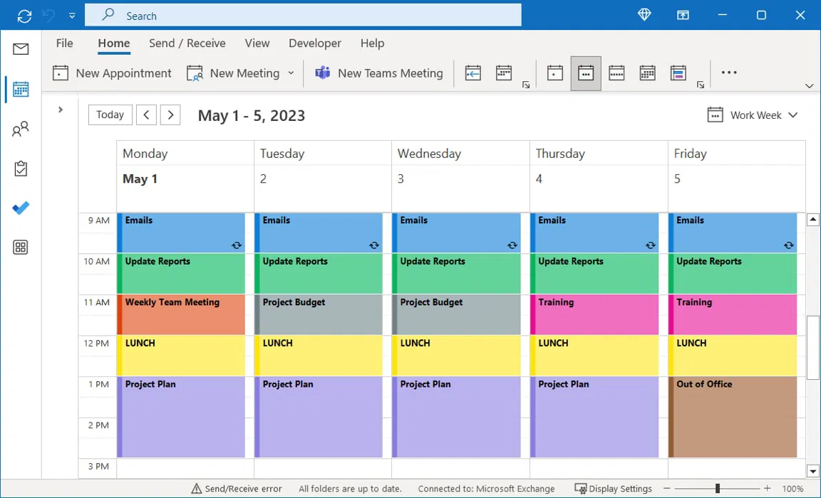
Protip: Block Schedule
Block a time(s) in your calendar that is solely focused on your tasks so you will be less likely to be interrupted.

Slide 9
"When everything is a priority, nothing is a priority." - Simon Fulleringer

Slide 10
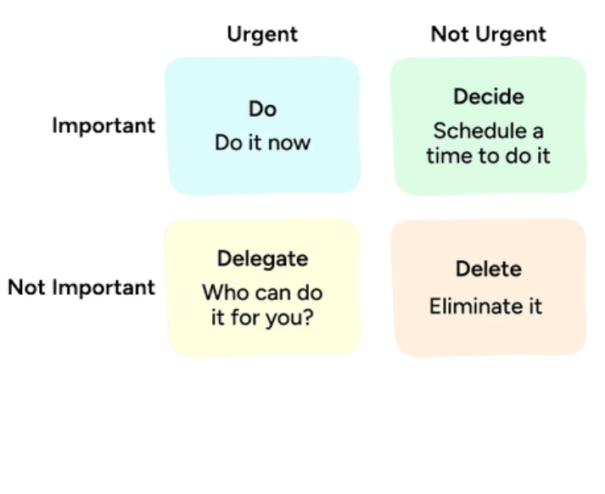
Which do you Prioritize?
City Council member wants to meet to discuss increasing publicizing city parks.
Signs are needed to notify the public that the Info Center will be closed in two weeks for staff training.
Recreation Departments wants to share an employee highlight post on the city social media.
*Eisenhower Matrix

Slide 11
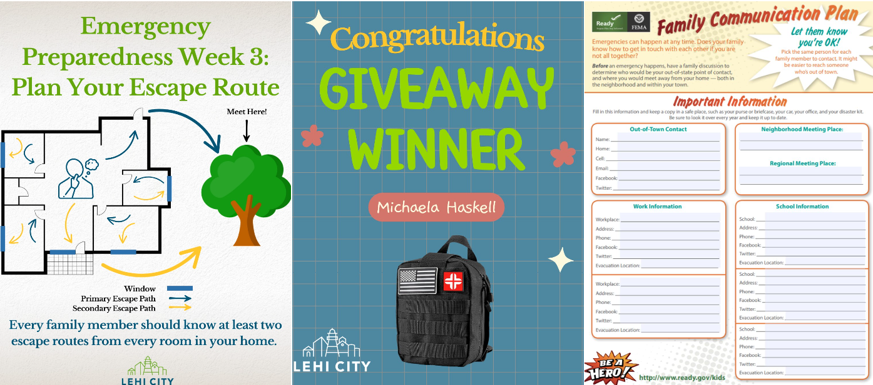
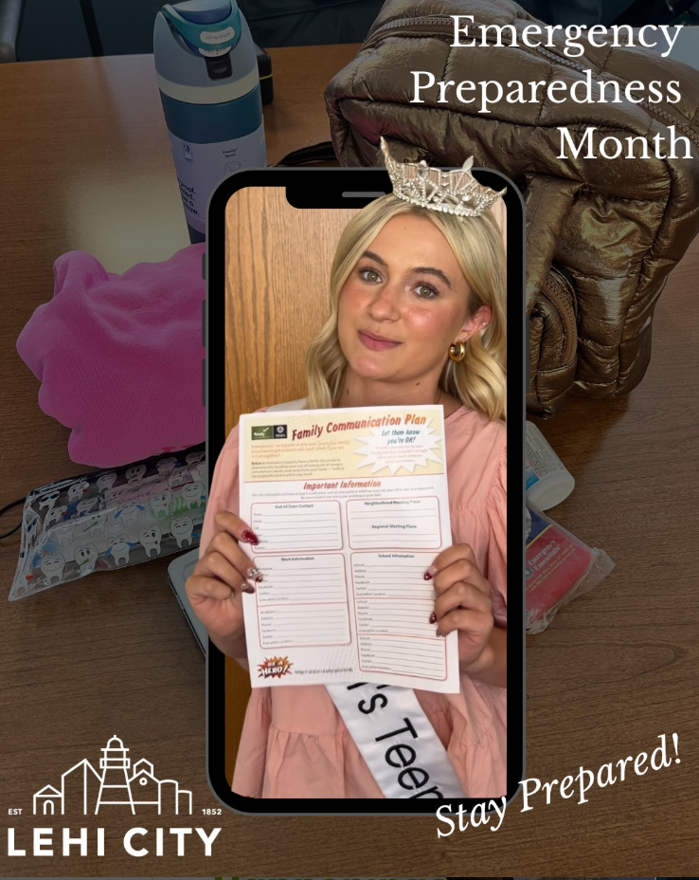
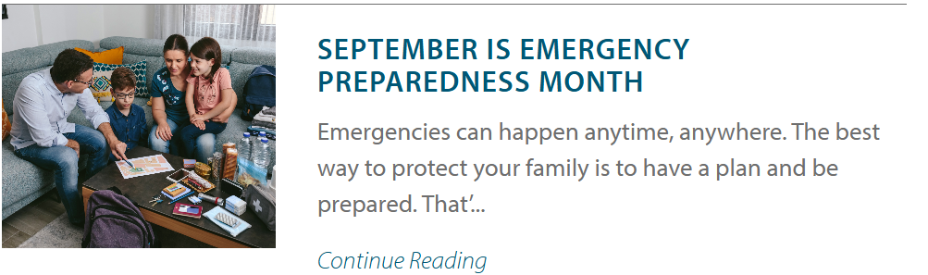

Slide 12
Trust
Why does it matter?

Slide 13
What challenges are you having with getting departments or residents to trust you?

Slide 14

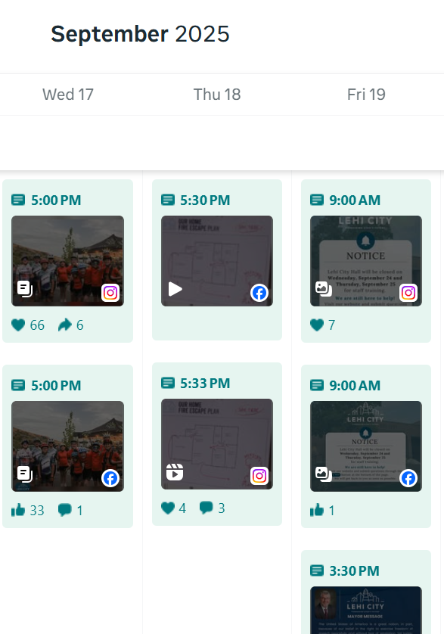
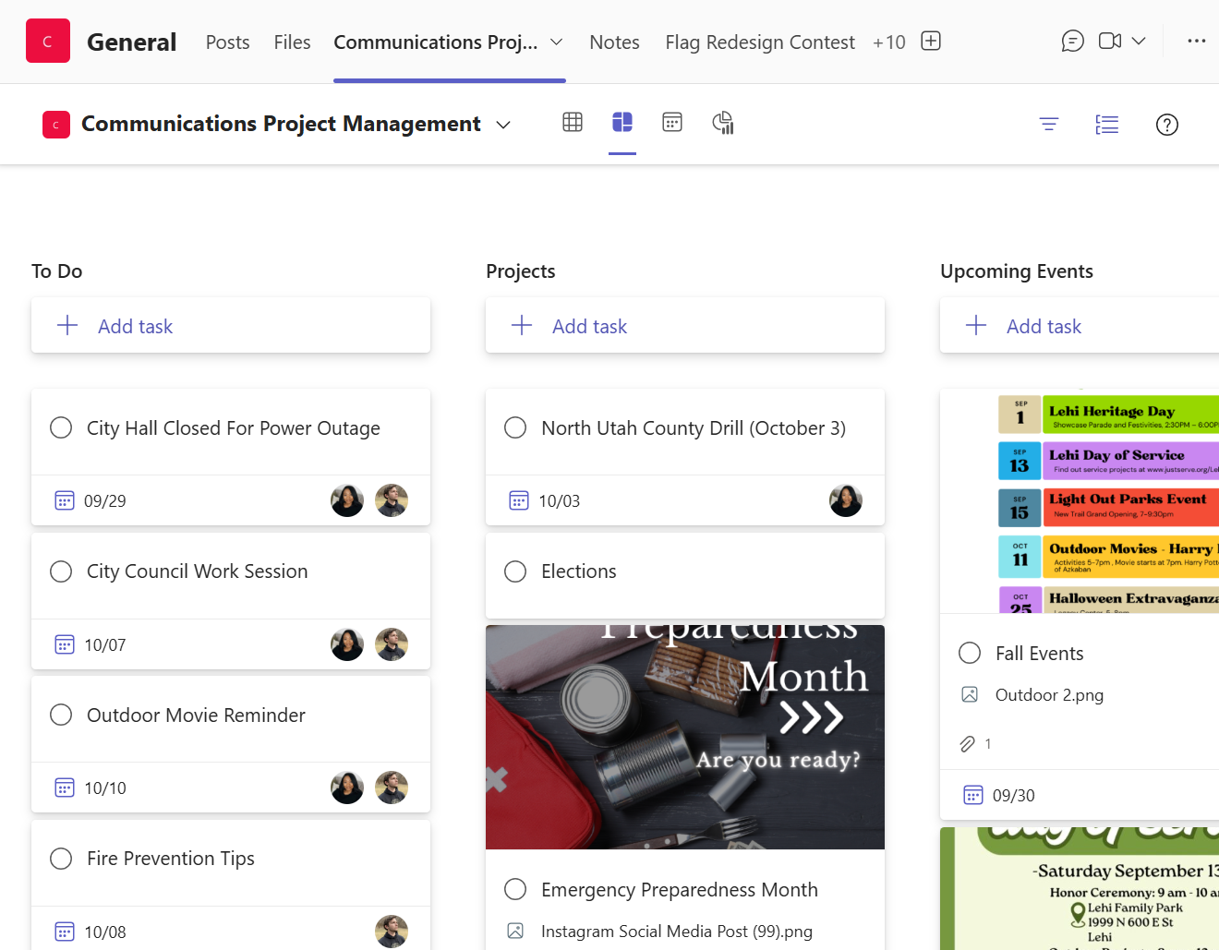
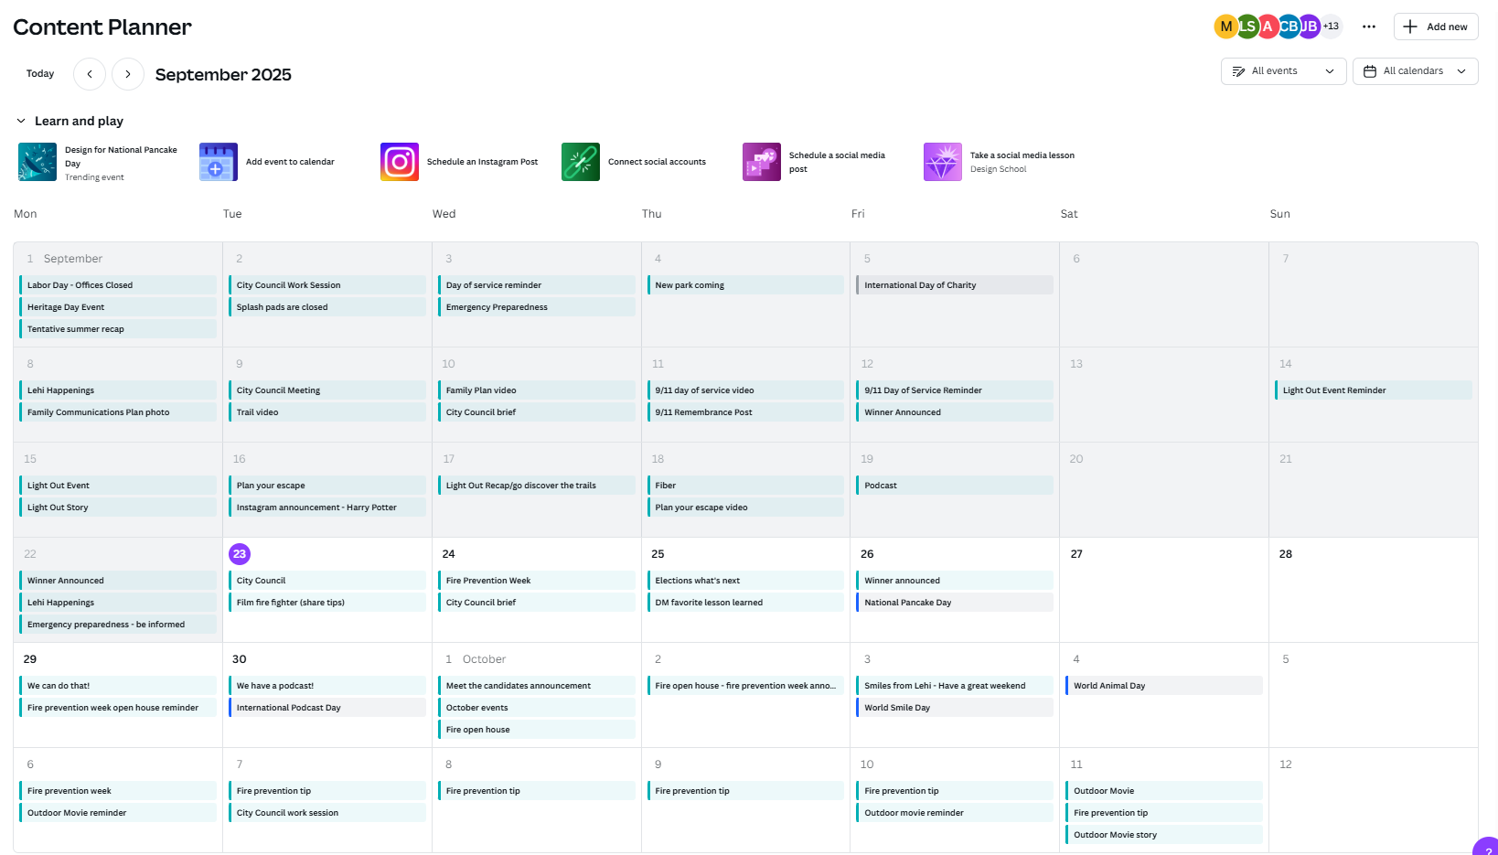
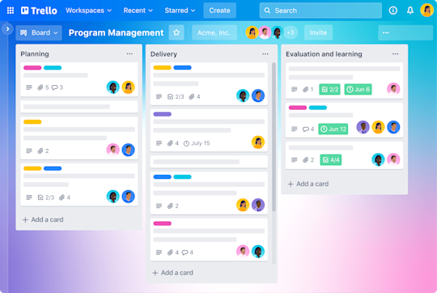

Tools to Keep You Productive

Slide 15
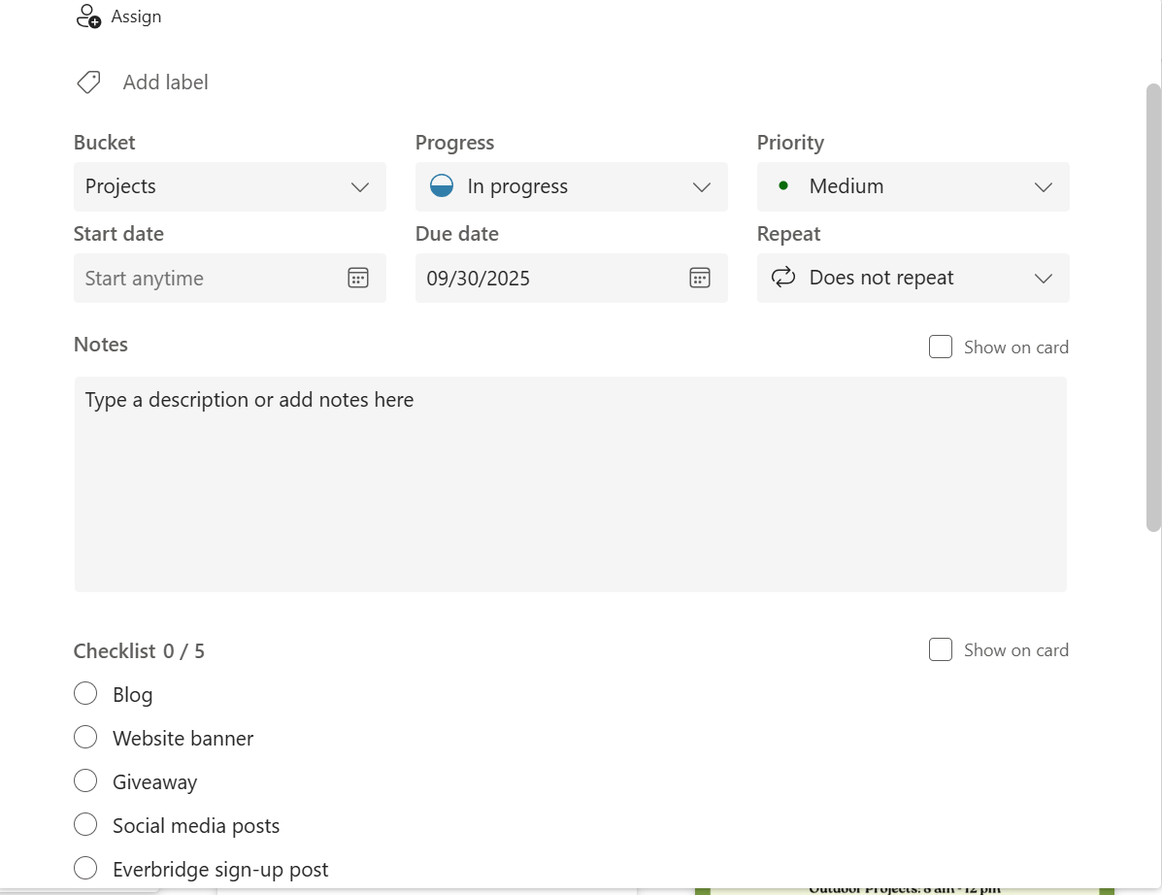
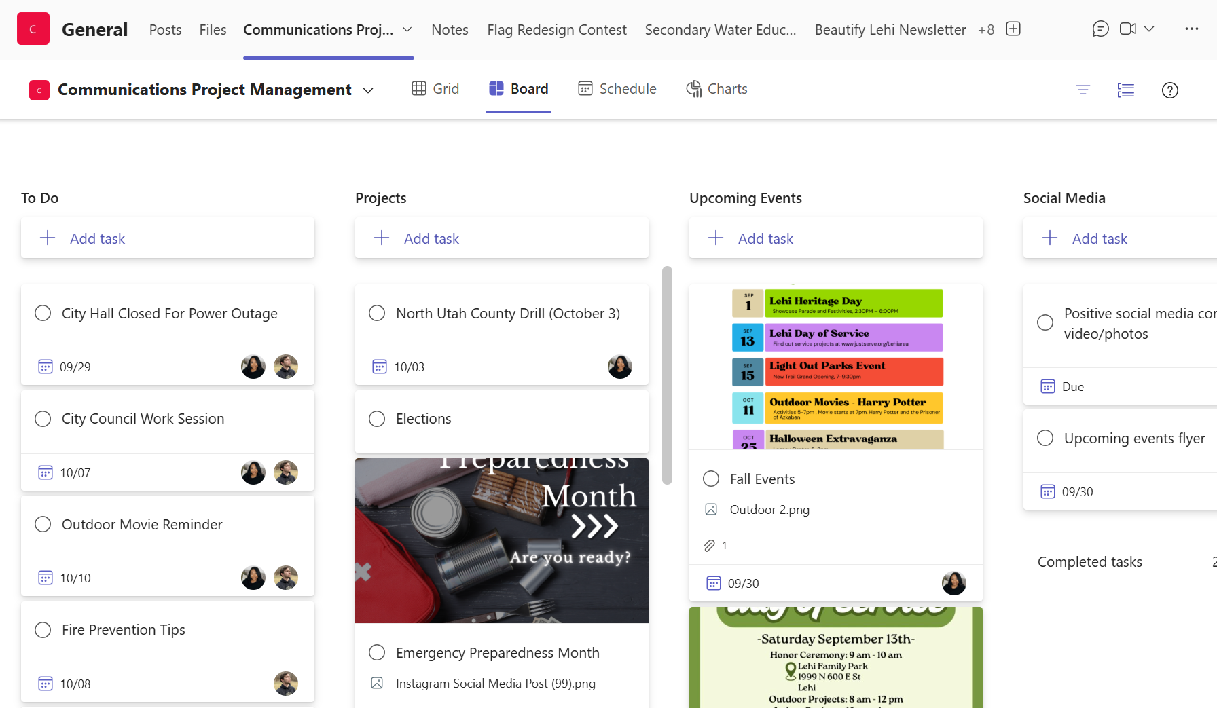

Slide 16
Stay Ahead of The Game!
Create a content calendar
Create a template for weekly social media, notices, and emergencies
Have statement templates ready in your email drafts with media contacts already loaded.
If you use an emergency alert system, have templates ready. (i.e. emergency road closure, power outage, etc.)

Slide 17
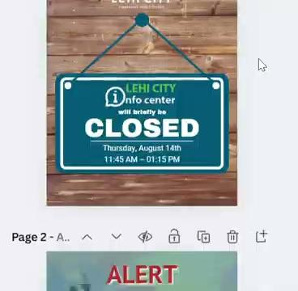

Slide 18
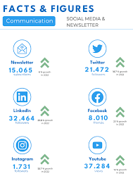
Traction: Prove Your Value
Create an annual communications report.
Your social media metrics
The department projects that you assisted you. Don’t forget to share the goals and what was accomplished.
Blog views.
Podcast listens.
Media Mentions.

Slide 19
“Metrics aren’t just numbers, they’re the story of how our communication is working. When we evaluate the data, we can see what’s connecting, what needs adjusting, and how to grow stronger with our audiences.”

Slide 20
Wrap Up: Small Team, Big Impact
  Tenacity keeps you going.
  Trust makes you stronger.
  Tools make you faster.
  Traction shows your success.
With these four, your small team can make a big impact.

Slide 21
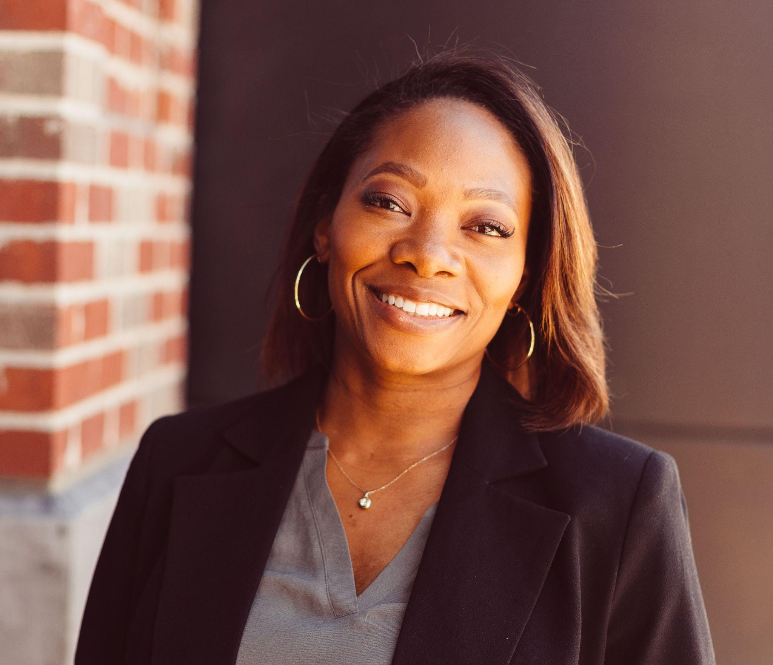
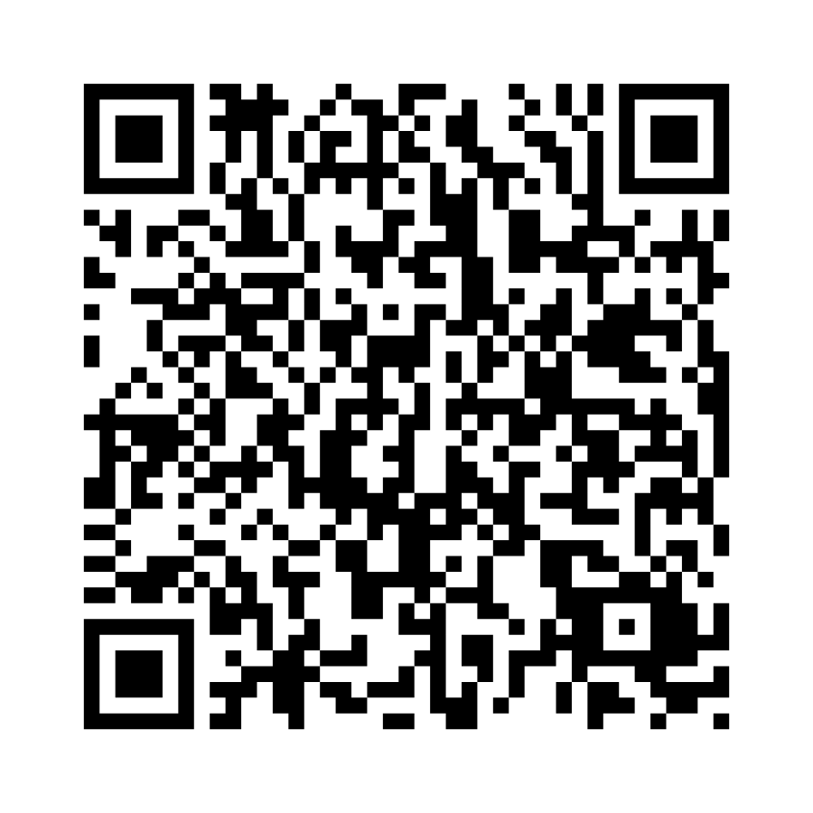

Q&A
Thank you!
Let’s Connect!
https://www.linkedin.com/in/jeanteil-livingston
Resources from the presentation

