Slide 1
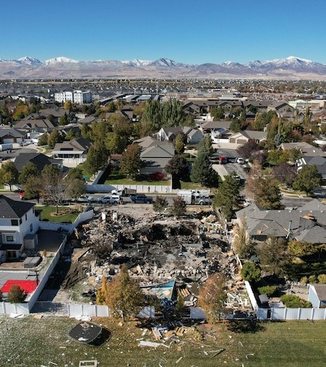
Teaming Up in Crisis:
Lessons from the South Jordan Gas Explosion
By Deputy Chief Ryan Lessner, MPA &
Rachael Van Cleave, MBA, APR, APIO
Notes:
We have worked together for 6 years on numerous public safety incidents.
We’re going to have breaks throughout to ask you questions, called “decision points,” about what you would do, and have quick discussions throughout.
While we will be running through a timeline, this presentation is all about people - trust, mental states, and meeting needs. So, we’re going to incorporate some elements of those things throughout.

Slide 2
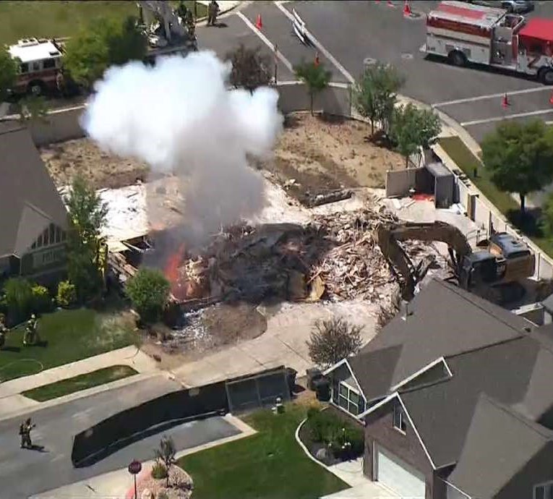
Takeaway # 1 - Relationships First
Know who you will be working with from different departments in an incident, and:
Meet with them now
Determine who handles which parts of the response
Make it clear that you are there to support them
NO EGOS
Show up and do what you said you would
Notes:
Rachael - Like we said, we want this to be a people-focused presentation, so our very first takeaway is Relationships First - and by first, we mean before the incident happens.
Ryan - Rachael and I worked on several incidents together like the McManigal House Explosives (pictured), numerous house fires, investigative pieces, and more. It was important for us to have an understanding and relationship to help these be successful, which we’ve built over time.
Here is our first takeaway:
Know who you will be working with from different departments in an incident, which means, you should:
Meet with them now
Determine who handles which parts of the response
Make it clear that you are there to support them
Show up and do what you said you would

Slide 3
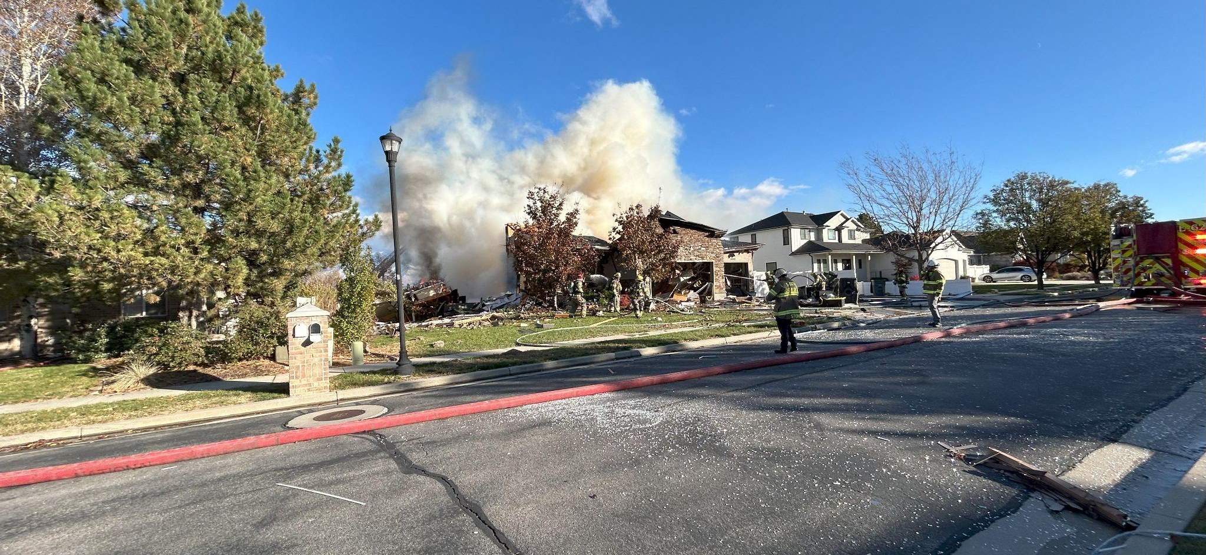

Timeline - Wednesday, November 6, 2024
3:09 p.m. - Dispatched to a report of a house fire/explosion
Notes:
Rachael’s perspective - First part of the story, I didn’t realized I had felt the explosion until later that day. Several of us felt it and commented on it at City Hall. Minutes later, an information center agent runs into my office and says - we’re getting calls about an explosion - Brian’s wife says it’s their neighbors house. Brian, is our economic development director. I follow the agent out and we catch Brian in the lobby as he’s answering a call from his wife. You can hear her frantic voice as she’s trying to explain what happened. He heads home immediately. I get the address, pack up, and head over.
Ryan’s Perspective -
3:09 p.m. - Dispatched to a report of a house fire/explosion - play audio
On scene, this is my first photo, running ICS system, assessing situation.

Slide 4
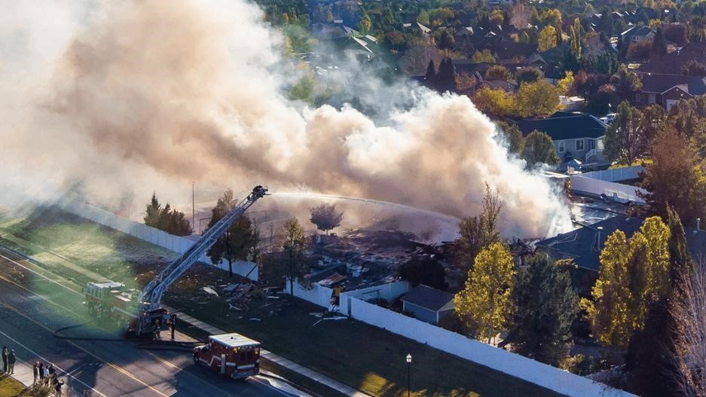

Situation - Wednesday, November 6, 2024
What we knew at this point
Significant damage from what appeared to be an explosion
Unknown cause
Initial reports indicating no one was in the home
Working to determine public safety risk and conduct initial evacuations
Source: KUTV
Notes:
Ryan -
Significant damage from what appeared to be an explosion
Don’t know what caused it
Initial reports indicating no one was in the house
Worked to figure out if there is ongoing danger and conduct initial evacuations

Slide 5
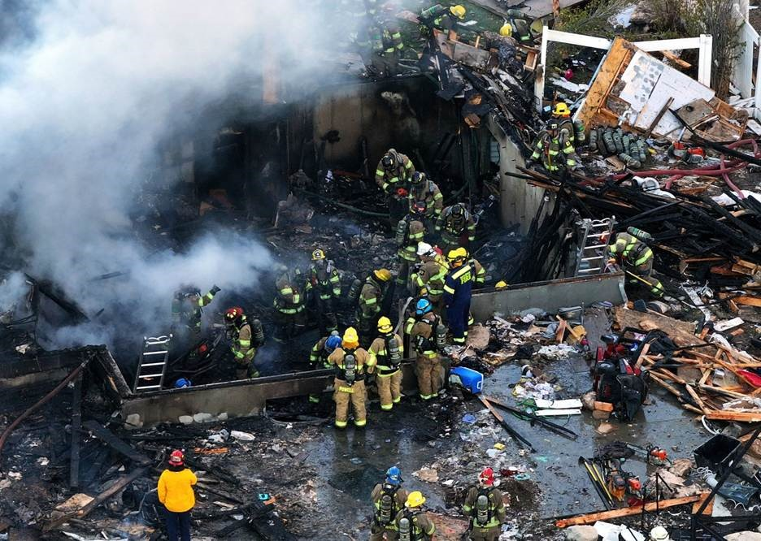
Timeline - Wednesday, November 6, 2024
3:09 p.m. - Dispatched to a report of a house fire/explosion
3:23 p.m. - Have a report from a neighbor that there may have been a juvenile in the house
3:32 p.m. - Family arrives on scene
3:45 p.m. - Rachael shows up, coordinates with PD on media staging and starts wrangling media
Source: KSL
Notes:
Ryan -
Between 3 and 7 p.m. aggressive fire suppression
Have a report from a neighbor that there may have been a juvenile in house
3:23 p.m. - Have a report from a neighbor that there may have been a juvenile in the house
3:32 p.m. - Family arrives on scene
Human element - Tell the Story of mom and how it changed operations at that point. Then, we hear someone scream, we figured out quickly that it was mom and that someone was in the house
Rachael - 3:45 p.m. - Rachael shows up, coordinates with PD on media staging and starts wrangling media
Start working with Fire to get briefing, determine DC Lessner as spokesperson
Starting setting up initial interviews

Slide 6
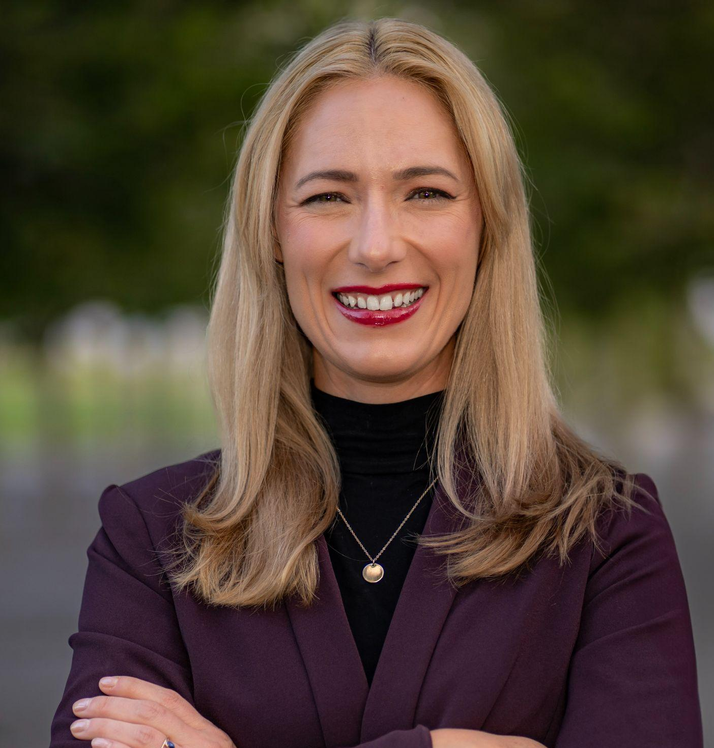
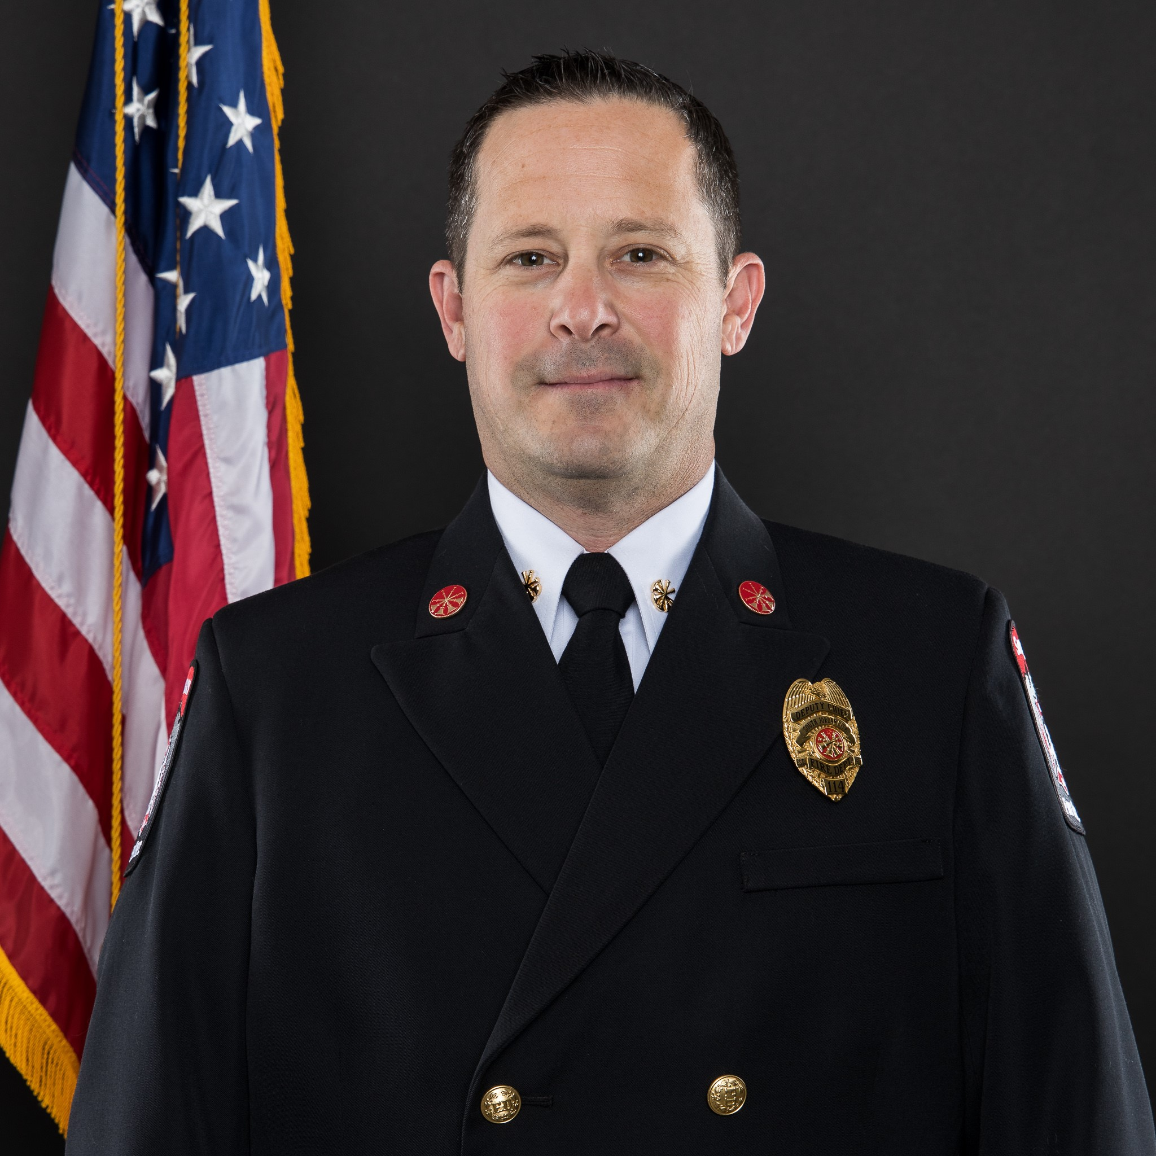
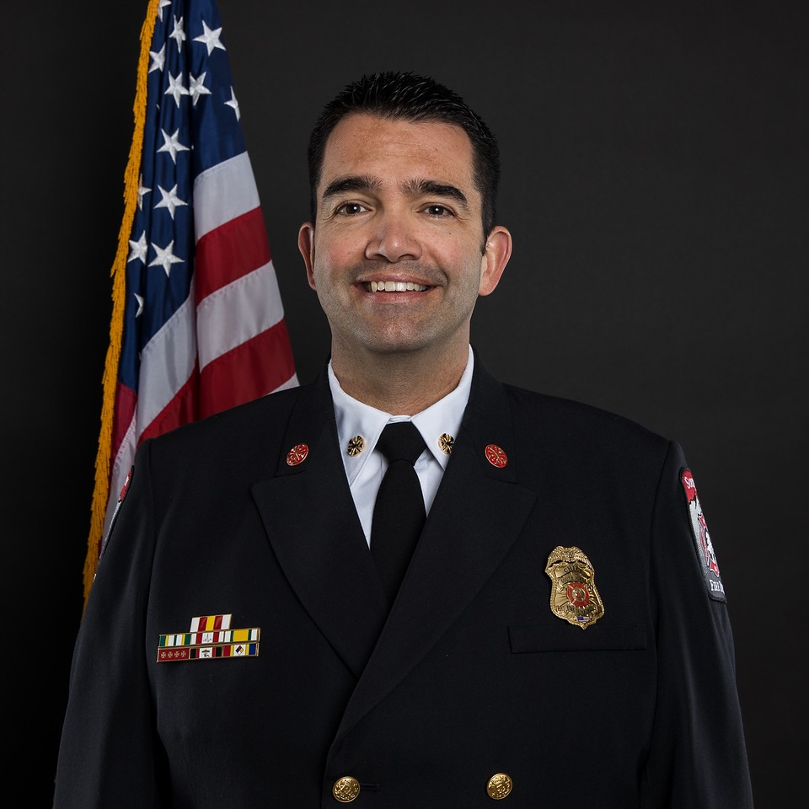

DECISION POINT
Who should be the spokesperson?
1
Rachael Van Cleave, PIO
2
Ryan Lessner, PIO
Deputy Fire Chief
3
Chris Dawson
Fire Chief
Notes:
Rachael - Decision Point! Knowing what you know at this point, who would you choose as the spokesperson and why.
Any of these could have been the right answer, depending on the needs of your team.
We felt like Fire should be on camera because of the visual and trust.
Ryan- talk through your decision process with the chief
Ryan and Chief had a conversation about who should be point - Ryan said he’d rather keep the chief “in his back pocket,” in case things escalated.

Slide 7
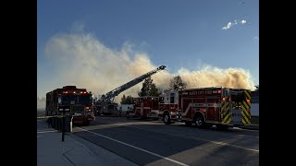
Initial Interviews - Wednesday, November 6, 2024
First Interviews - 4:35 p.m.
Initial Key Messages
Searching for missing family member (un-identified)
Fire crews working to suppress fire and determine area safety
Notes:
Rachael talks through wrangling media, talking through key messages with Ryan, and setting up the initial round of interviews.
Ryan talks about what he was thinking at this point.
Play clip.

Slide 8

News Release #1- Wednesday, November 6, 2024
Established initial details of incident
Ran it by stakeholders: City Manager, Assistant City Manager, Fire Chief, and Deputy Chief
Quick Release 5:50 p.m.
Notes:
After the initial round of interviews, I ran back to my car to prep the initial release.
Needed to think through political aspect and make sure key stakeholders were included.

Slide 9
Takeaway # 2 - Have a Go Kit
In your car, have the following ready:
Winter - Coat, gloves, ear warmers, hand warmers, shoes/boots you can walk in, etc.
Spring & Fall - Coat, rain coat, umbrella, etc.
Summer - Sunscreen, hat, sunglasses, walking shoes/boots, etc.
All seasons - water, snacks, PPE, etc.
*This is a non-exhaustive list, but some basics!
Notes:
Also note, I was freezing because I had expected to be working in office all day and did not have warm enough attire. After that I keep a warm coat and other items in my car.
I am pretty sure the Fire and police peeps were laughing at me. I got offered a coat more than once!

Slide 10
More Interviews - Wednesday, November 6, 2024
Second Round - 6:30 p.m.
Key Messages
SJPD working to locate missing family member
Ongoing fire suppression and search efforts
Verified with gas company that there is no immediate threat
Can’t speculate on location of family member
Notes:
Ryan was hesitant to respond to media at this point because there was no new information. He decided to go ahead and do the interview to give them something. [Maybe cut the last piece out with Andrew adams about the body being found]
[Potential decision point - If you have info, but can’t share it, what do you do when the media is there] - Ahead of the video clip.
They are asking questions about social media - we know it’s the kid, we know his name, why aren’t you telling us…

Slide 11
Takeaway # 3 - Give them something
Even if you have no new information, give the media something even if it’s simply
“We have no new information at this point.”
Notes:
Ryan was hesitant to respond to media at this point because there was no new information. He decided to go ahead and do the interview to give them something.

Slide 12
Timeline - Wednesday, November 6, 2024
7:51 p.m. Body Found, Operations Paused
  Fire Chief Chris Dawson notifies family of the death
Neighbors and friends tell news media and post to social media that it is a student from Bingham High School that died
Beginning at 8 p.m. media starts pushing for confirmation of the details
Family asked the City not to release the name or any other details
Notes:
Ryan -
7:51 p.m. - Body found, Fire Chief Notifies family - what was everyone thinking and feeling at this point?
Then:
Neighbors and friends tell news media and post to social media that it is a student from Bingham High School that died
Beginning at 8 p.m. media starts pushing for confirmation of the details
Family asked the City not to release the name or any other details

Slide 13

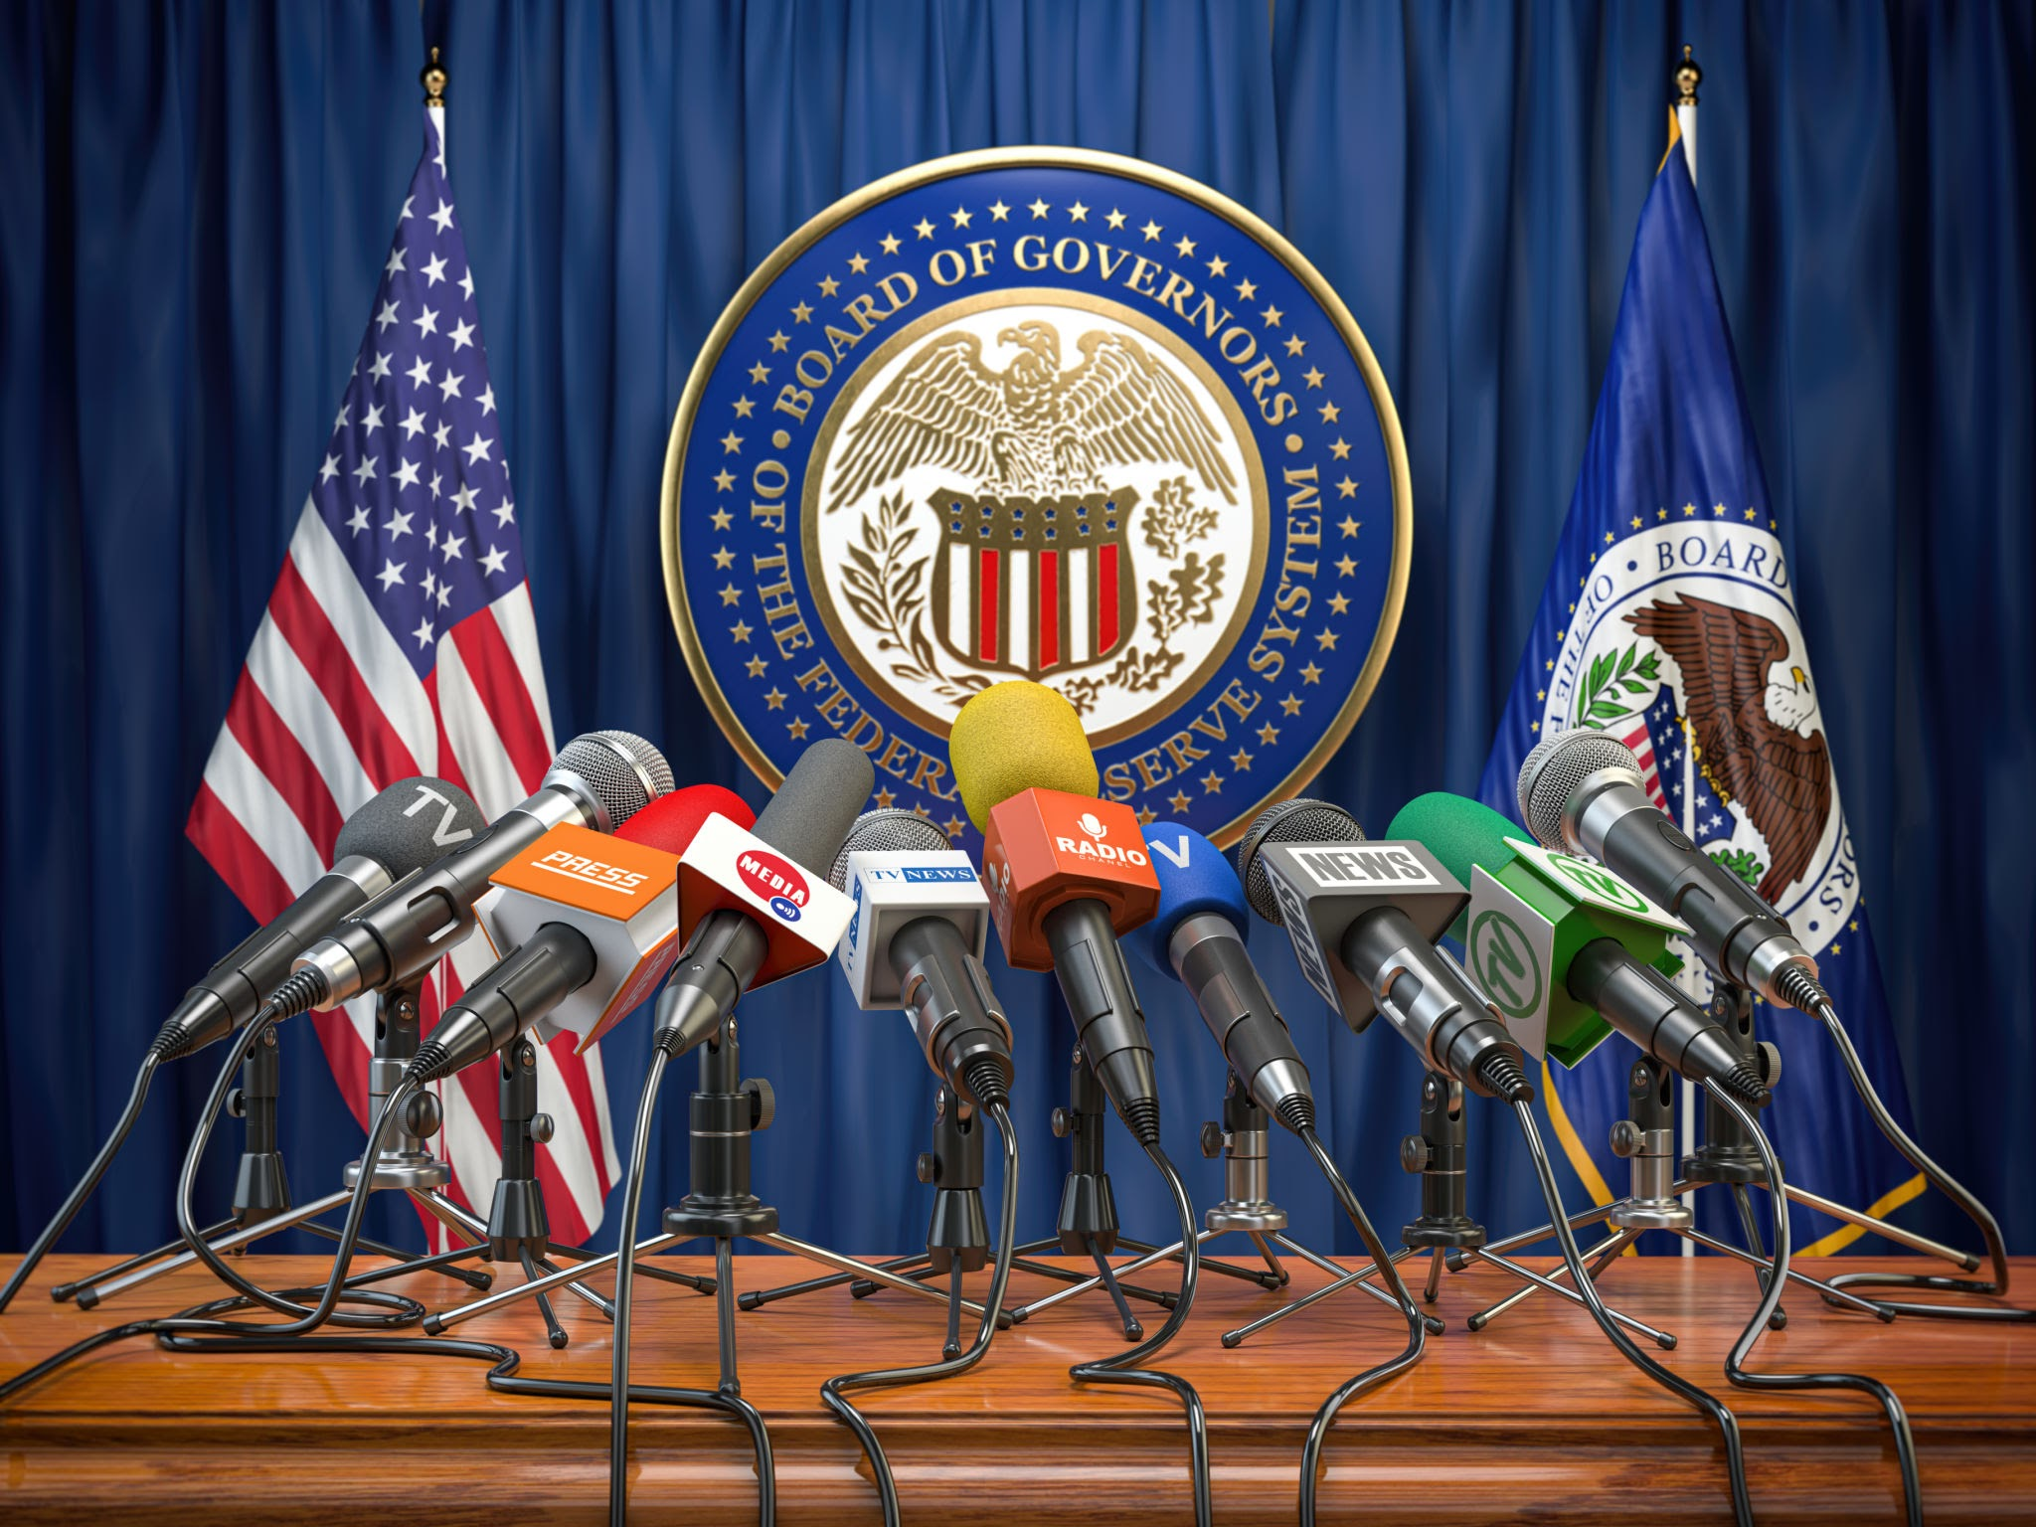

DECISION POINT
Which would you have done at this point to manage the media versus family’s wishes?
1
Push out a release
2
Host a press conference
3
Release nothing - “It’s under investigation.”
Notes:
Which action would have taken next, given that the family asked us not to release names or details about their family member?

Slide 14
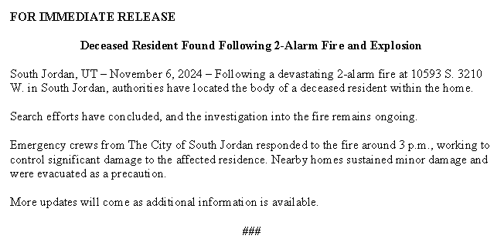
News Release #2 - Wednesday, November 6, 2024
Release/Update - 10:10 p.m.
Deceased resident found
Search efforts are done
Investigation is ongoing
Notes:
We decided to put out a release with the information. Ryan wanted to shift to operations more. I put my info on the release.

Slide 15
Timeline - Thursday, November 7, 2024
Shift in strategic priorities
  Active investigation with Utah State Fire Marshal, local investigators, gas company, Bureau of Alcohol, Tobacco, Firearms, and Explosives (ATF), and National Transportation Safety Board (NTSB)
  Deputy Chief Ryan Lessner becomes family liaison
  Communications transition plan
8:00 a.m. - 11:00 a.m.
  Family agrees to allow us to release age and school information, but not name
  Family starts seeing disturbing inaccurate information on social media
  Prepare next news release
Notes:
Ryan - PD hands off to us - I become the family liaison. What did that entail? You mentioned preparing them for media to pull records (GRAMA)
Family agrees to allow us to release age and school information, but not name.
Family starts seeing disturbing inaccurate information going around about the incident.
Disturbing examples: meth house, drugs, etc. ←-Ryan, I couldn’t find any examples of online stuff, I want to say this is something I heard from you.
Check on involvement of Alcohol, Tobacco, and Firearms (ATF),

Slide 16
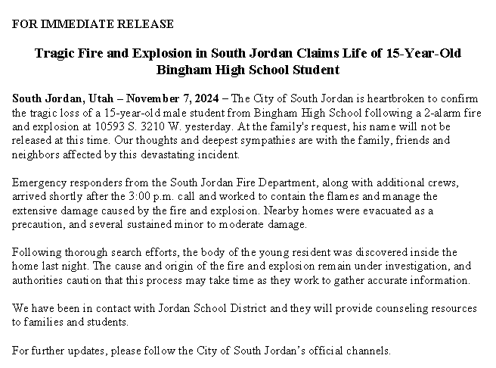
News Release #3 - Thursday, November 7, 2024
Release/Update - 10:50 a.m.
Key Messages
Compassion statement
Family requests no name to be released
Allows us to release age and school
The cause is still under investigation, but the City believes there is no immediate threat
JSD is offering mental health resources
Notes:
We put the family’s request to not release the name or details into the release, and most media followed that out of respect.
Mayor Ramsey could speak to it and put a message out on her channels. [Screenshot]

Slide 17

DECISION POINT
Which 2 of the following decisions do you think we made next?
1
Pushed out a release
2
Ryan hands off media response to Rachael
3
Nothing because the NTSB was taking over the investigation

Slide 18
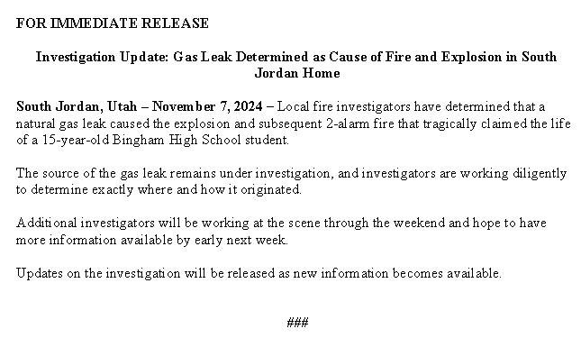
News Release #4 - Thursday, November 7, 2024
Key Messages
Gas leak is determined as cause
Source of leak is still being investigated
More investigators are coming to determine where the leak is as soon as possible
Release - 6:45 p.m.
Notes:
Ryan hands off media response to Rachael
Rachael puts out a statement
Ryan -
Had a lot of internal conversations about what the right information was to put out to residents - we talked with legal about putting out the initial information and got the nod.
Preliminary investigation determines cause as gas leak.
City determines that releasing the preliminary investigation results was the best option for residents and the family.
Ryan is entrenched in operations and as the family liaison and tells Rachael that he doesn’t want to talk to the media because he doesn’t want to put out any misinformation or unconfirmed unintentionally

Slide 19
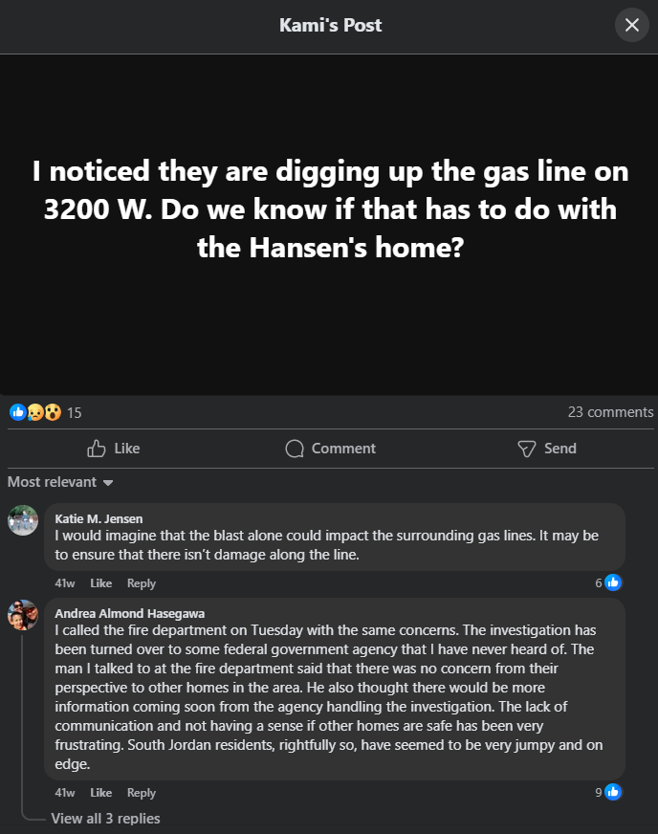
Timeline - November 8-13, 2024
NTSB takes over investigation and any media response should go through them.
Over several days, numerous investigators come on scene, from gas company, NTSB, State Fire Marshal.
Gas company starts working on the road behind the house.
Residents start to get nervous and want more information. Is it safe?
Notes:
At this point, we’re seeing resident concerns because they’re seeing gas folks. People are seeing gas company employees checking people’s homes because they are calling in, causing more fear. Fire Dept. and Mayor/Council getting fearful calls.

Slide 20
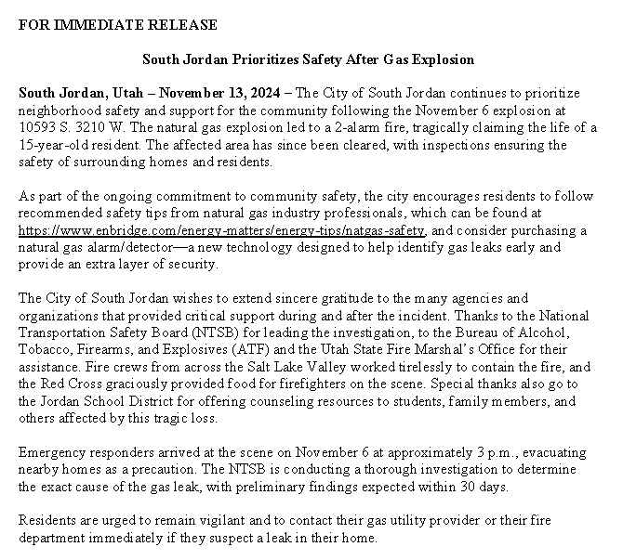
News Release #5 - Wednesday, November 13, 2024
Release - 12:45 p.m.
Key Messages
Gas leak safety information - natural gas detectors
South Jordan’s investigation has concluded and NTSB has taken over
Contact your Fire Department if you suspect a gas leak
Notes:
Rachael -
We decided to put out a release ensuring residents that we prioritize their safety (Enbridge wouldn’t put out info, and NTSB wouldn’t put out info until their preliminary report). Due to residents being scared about risks to their homes due to gas leaks. At this point, the NTSB had taken over so anything we put out had to be passed by their public affairs person for approval. We came up with this statement.

Slide 21
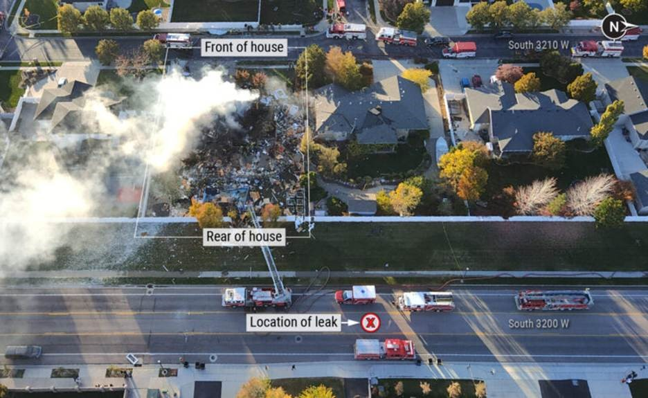
Timeline - Wednesday, November 20, 2024
NTSB releases report confirming gas leak
We see a lot of online discussion and get phone calls from concerned residents

Slide 22
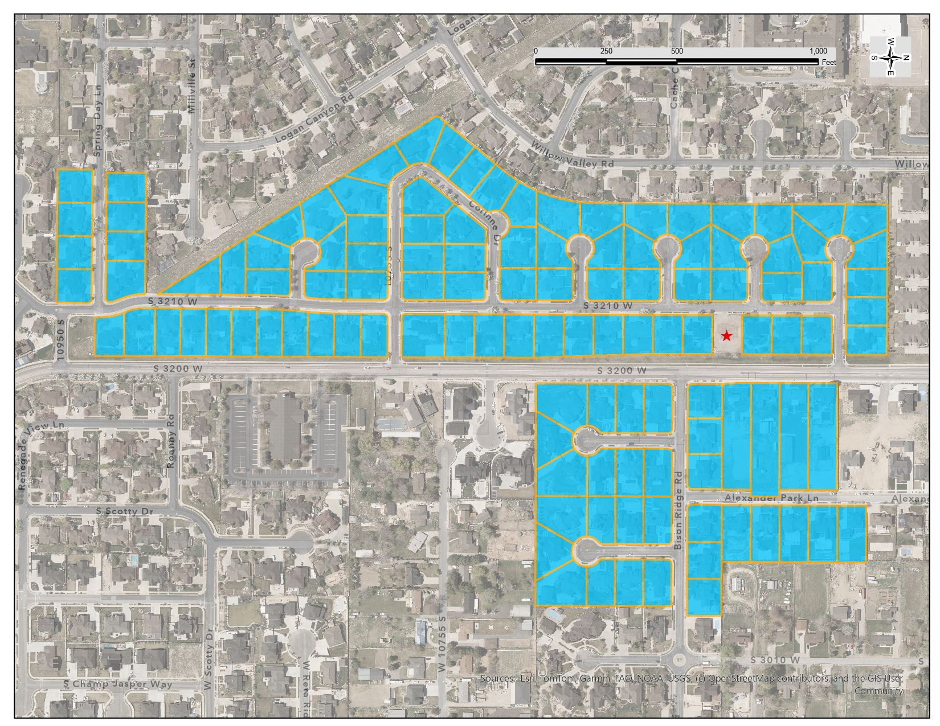
Community Outreach - November 20-22, 2024
The Fire Chief and Deputy Fire Chief went door to door to answer questions, and respond to resident concerns
Ended up going to 118 homes, and talking with 200+ people
Followed up with town hall meeting
What We Heard From Residents
We don’t trust the media
We don’t trust the gas company
We trust the Fire Department

Slide 23
Takeaway # 4 - Trust is everything
“The community trusts us with their most valuable possessions”
Notes:
When you hear about a fire fighter doing something wrong it’s not “Joe Smith” did this, it’s “Fire fighter Joe Smith”
We are held to a higher standard
Ryan - The community trusts us with their most valuable possessions. They will hand over their infant to us as strangers, because they trust us, and we won’t do anything…

Slide 24
What Worked Well
1
Relationship Building
2
Putting People First
Candid conversations
Establishing clear expectations of roles (who leads, who supports etc.)
No Egos Amigos
Advocating for the family to the media
Supporting our community as a trusted source of information
Compromise - Ryan’s desire to not talk with media
Face time - DC Lessner and Chief Dawson spent tireless hours knocking on doors and answering questions
Notes:
Ryan - Relationship Building
Rachael - Putting People First
Advocating for the family to the media – We asked the media not to release their child’s name.
Compromise - Rachael listened to Ryan when he said he did not want to go on camera because he didn’t want to release anything accidentally/unofficial. She found a work around (statement).
Face time - DC Lessner and Chief Dawson spent tireless hours knocking on doors answering questions and concerns of immediate neighbors and some beyond because they knew they were more trusted than other sources and it’s what the residents needed.

Slide 25
Takeaways
Finally…Let’s be NO EGOS AMIGOS Together!
Final Reminders
Build relationships with those you know you’ll work with in an incident
Put people first
Release something – Even if it’s just a statement, you are an official source.
Leverage trust - Figure out who your residents trust (and, of course, be trustworthy!)
If you work for fire - reach out to your city PIO and visa versa.
Notes:
Build relationships with those you know you’ll work with in an incident – meet with them, communicate regularly, participate in table top exercises together.
Put people first – if your residents, constituents, your staff, or the public are your priority, then you will do the right thing even if that means not releasing information the media is interested in.
Release something – Sometimes you don’t have anything to say, or things you can’t say. Give the media something they can report on no matter how small and they’ll be grateful, even if it’s just a statement. If you don’t release it, people fill in the gaps with incorrect and some time harmful information.
If you work for fire - reach out to your city PIO.

Slide 26
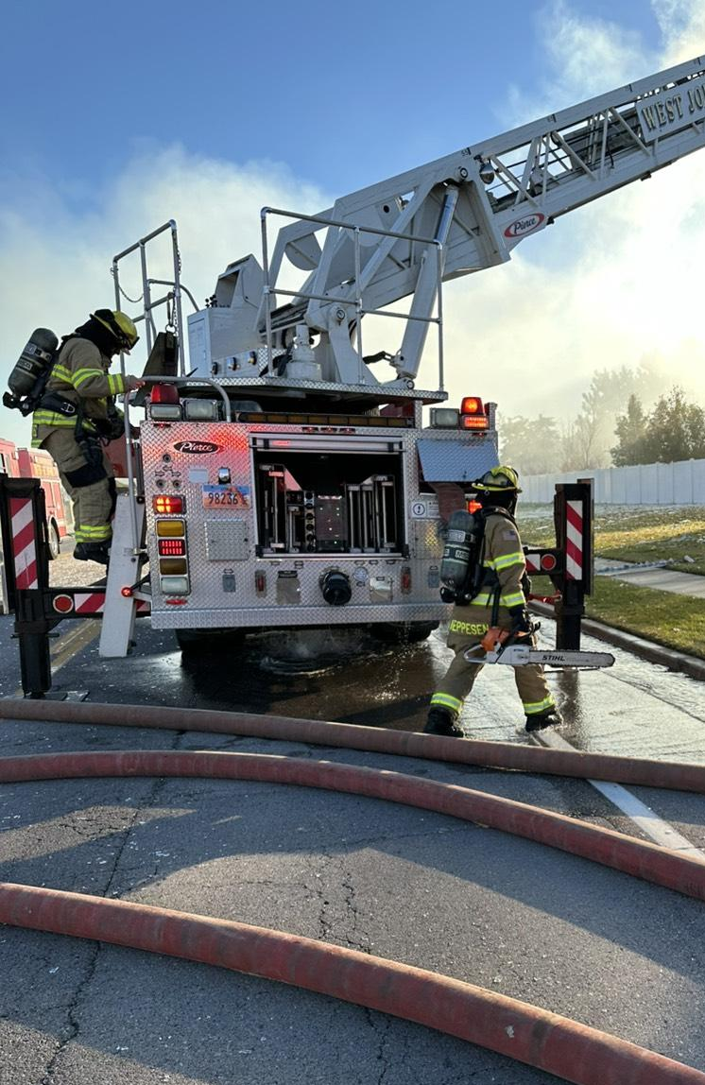


Questions?
Connect with us on Linkedin
Ryan Lessner, MPA
Rachael Van Cleave, MBA, APR, APIO

