Slide 1
Making it easy as pie for the media to cover your story
Pitching Stories to Get a
Home Run

Slide 2






WIIFM?
What will the reporter, media outlet, or the audience get from the story?
How will they benefit?

Slide 3
TPPICHU
Timeliness
Proximity
Prominence
Impact
Conflict
Human Interest
Uniqueness
News Judgement Factors

Slide 4

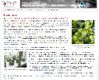
So, what’s the difference between a news release and a pitch?
News Release
  Distributed to multiple media outlets
  Tells the same story to all outlets
  Generic as far as style and format
Story Pitch
  Directed at an individual
  Designed to fit that medium’s format or style
  Lays the story out for the medium making it very easy for them to do the story

Slide 5



I was once a PIO too!
Washington State University’s Prosser Irrigated Agriculture Research and Extension Center (IAREC)

Slide 6
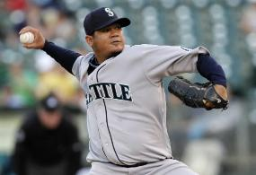
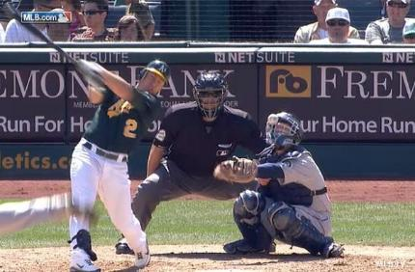
Pitching stories is like pitching baseball… sorta
Instead of striking the batter out, we want to media to hit a home run.
Notes:
Low and outside. May be situation…

Slide 7




Warming up for the pitch
Establish a relationship with the media
  What are they interested in?
  How do you get the information to them?
Research the individual’s work
  Company philosophy
  Special editions/themes/shows
  Writing/work style
Notes:
Christine Brown – KNDU
Geraldine Warner – Reporter based out of Wenatchee

Slide 8
Warming up for the pitch
What is your goal?
  Trying to reach seniors?
    KSL 6 p.m. or Positively 50+
  Younger demographics?
    Try FOX 13 morning
  Young Professionals?
    Try 2 News at 5
  Affluent, educated, artsy audience?
    Salt Lake City Magazine
  Sports fans?
    KSL Sports Zone
Notes:
Quick Google Search

Slide 9
Warming up for the pitch
What do you have to offer?
  Expertise on a hot topic
  Visuals/Audio
  Unique perspective
Notes:
Poli Sci Todd Schafer…
Sheree
Tom equipment manager at Weber. Brett… KSL did story on WSU equipment.

Slide 10
Stop. Think. Brainstorm.
What’s a story you’d like to pitch?
Who might be a reporter you could target to pitch stories?
How would you research that reporter?
What can you offer the reporter in terms of expertise, visuals, etc.?

Slide 11

Preparing the pitch
Keep the seven news judgment criteria in mind
  T.P.P.I.C.H.U.
Keep it short and sweet
  E-mail the basics. Give them links to details or email details separately
Know your medium
  What would the reporter need to produce a kick a** story?

Slide 12

Preparing the pitch
What material do you have to offer?
  Pictures
  Video
  Expert interview
  Location
  Exclusivity

Slide 13

Making the pitch
Timing is everything
  Don’t pitch before a deadline
  Tie your pitch into the news
Keep it short and sweet
  E-mail the basics.
  Give them links to details.
Respond/Follow up
  Return call before deadline

Slide 14
Making the pitch
Pitch the same story to different media outlets, but give it different twist
  Media outlets want to be unique
  Different outlet, different angle

Slide 15
Stop. Think. Brainstorm.
Let’s say you are going to pitch stories to:
  television reporter
  a radio news talk show producer
  a newspaper reporter
  an industry blogger or magazine
How would your pitch differ from one reporter to the other?

Slide 16





Story Pitch Examples
From my days at the
Irrigated Agriculture Research Extension Center

Slide 17


Butterflies
The Story
Pitch to KNDU Morning Show
Bug doctor writes book about PNW Butterflies
Great photos
Dr. David James
Ideas for segments
  The book
  Butterfly near Moxee
  Study to attract good bugs to vineyards
  How to attract butterflies

Slide 18

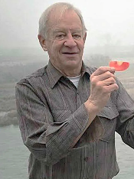
Prosser Bulletin
KNDU-TV
Cherry Blossoms
Same story.
Different outlets.
Different angle.
Notes:
Bill Howell

Slide 19


Microarray

Slide 20
Stop. Think. Brainstorm.
Questions?
Ideas?
Thoughts?

Slide 21
Terri Reddout terrired55@gmail.com
Pitching Stories to Get a
Home Run

